Slide 1
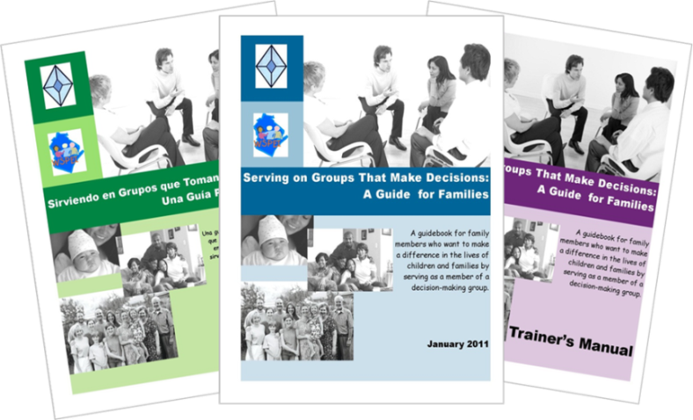
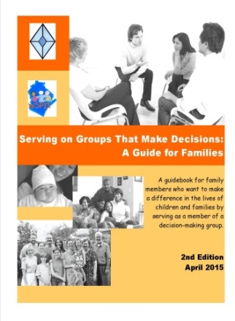
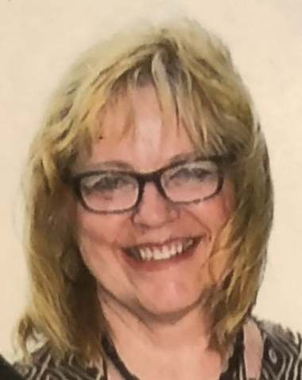
Serving on Groups
That Make Decisions:
A Guide for Families
7. Role of Families on Groups
8. Skills for Serving on Groups
November 3, 2022 www.servingongroups.org
877-374-0511
Jan Serak, M.A.
Serak Consulting Services
Notes:
Slide 1.
WEBINAR LOGISTICS
Procedural Directions for WEBINAR:
3 weeks ahead, review PPt Notes. Make sure to check to make sure links are current for all slides, especially the RESOURCES slides. Find replacements if needed.
Look up the Survey Monkey eval. link & QR code for this webinar. Put on last slide.
Create new HO1. Load the 5 Handouts into GTW.
Create any polls in GTW a week in advance of the webinar.
Day before, copy registrant list & use it to email everyone the 5 HOs.
Have a copy of the Handouts and this PPt with NOTES with you to present.
Show the slide
Presenter Notes:
Moderator, Presenter should ALL call in using a land line. Turn your your computer speakers off.
Load onto your desktop the PowerPoint (NOT the .pdf version), open to slide 1.
All handouts should already be uploaded into the Go to Webinar program.
Access Go to Webinar: http://www.gotomeeting.com/webinar/customer
Click “Sign In”- User - csalzer@wifacets.org Password - wifacets1
Choose “My Webinars”/left panel. Click “Upcoming Webinars”-find today’s webinar
Click “Start” (NOT “Practice”) to get the Go to Webinar Control Panel to open the GTW Control Panel on your screen.
On PPt, click Slide Show & From Beginning (to get Slide 1 to show up on your screen).
Under “Screen Sharing” section at top of Go to Webinar Control Panel, click “Settings” Type in the box where the recording should be saved if you want it saved in a specific file (ie, other than just downloaded documents)
Label the file. Click on Browse - and OK to direct it to save. As: T: 2022 workshops/2022-11-3SOG7&8
Under the “Audio”, section, Click “Phone” – Dial phone number listed, when asked type in the code # for the call, then the # to connect your phone. (Remember to turn your computer speakers off so you don’t get feedback.)
At this point, any WI FACETS’ staff can hear you, but not the whole audience.
Under “Screen Sharing” section, Click “Show My Screen” so you can see your screen.
(You can check “Audience View” to make sure your screen is showing properly - Should say “On Air Showing Screen” also)
------About 4 min before actual start time, click Start Broadcast on in the box at the top of Go to Webinar; push *1 on your phone. (Everyone can hear you now Say, “Hello to those of you on the line already. Your lines are muted. We will be getting started shortly.”
-------Promptly at scheduled start time….
“Welcome everyone to our WI FACETS Webinar.” This is “Jan Serak” on behalf of WI FACETS.” Before we get started, I would like to quickly address a few logistics…
---Everyone’s audio is muted; you need not worry about muting yourself. We have done this to maintain a high level of audio quality.
---To ask a Q, you can type it into the Question box in the GTW box on your screen. I will try to watch for questions.
---- The HOs have been uploaded to your Go to Webinar Control Panel. You may download them directly from there. -I also emailed them to everyone registered by Wed. am.
-Or, WI FACETS can send them to you after the webinar. Phone number is on your screen.
---A brief eval. will be emailed to you about 2 hours after today’s webinar. We appreciate you taking a few min.to complete it right way. It’s also in the Chat box to do right after webinar.
---Finally, this webinar will be recorded & will also be sent to you with our follow-up email.
---- “We will start the Recording now...” Click Start Recording button. Make sure the recording button goes from RED to GREEN!!!
================================================
Hello and welcome to today’s webinar. This is the 5th & last webinar in our Serving on Groups that Make Decisions webinar series.
My name is Jan Serak. I am the founder & former (now retired) Executive Director & CEO of WI FACETS.
I am also the Director of Serak Consulting Services, LLC, where I work with nonprofit agencies to provide training for Boards of Directors & others, like for you all today, also interim agency management and other services.
I am the parent of two adult sons, one of whom has autism.

Slide 2

Agenda
Serving on Groups Overview
  Family Engagement & Leadership
Section 7. The Role of Families on Groups
Section 8. Skills for Serving on Groups
Resources
Notes:
Slide #2: Agenda
Procedural Directions:
Show the slide.
Presenter Notes:
Here’s the agenda for today:
We’ll do a quick overview of the Serving on Groups Guidebook resource.
There are 8 sections in the Guidebook. Today we will cover Sections 7 and 8
We will end with some additional resources for you.
Your handouts include: the PowerPoint slides for today, the complete Sections 7& 8 from the Guidebook, and a few more.
First, as we have done in the other SOG webinars, here’s a quick Poll to see…
POLL #1 - what experiences you have had serving on decision-making groups: (Multiple Choice/Multiple Answers)
□ I’ve never served on a decision-making group
□ I have served on a decision-making group before
□ I am thinking about joining a decision-making group
□ I am serving on a decision-making group/s now (write group name/s in the Chat Box)

Slide 3
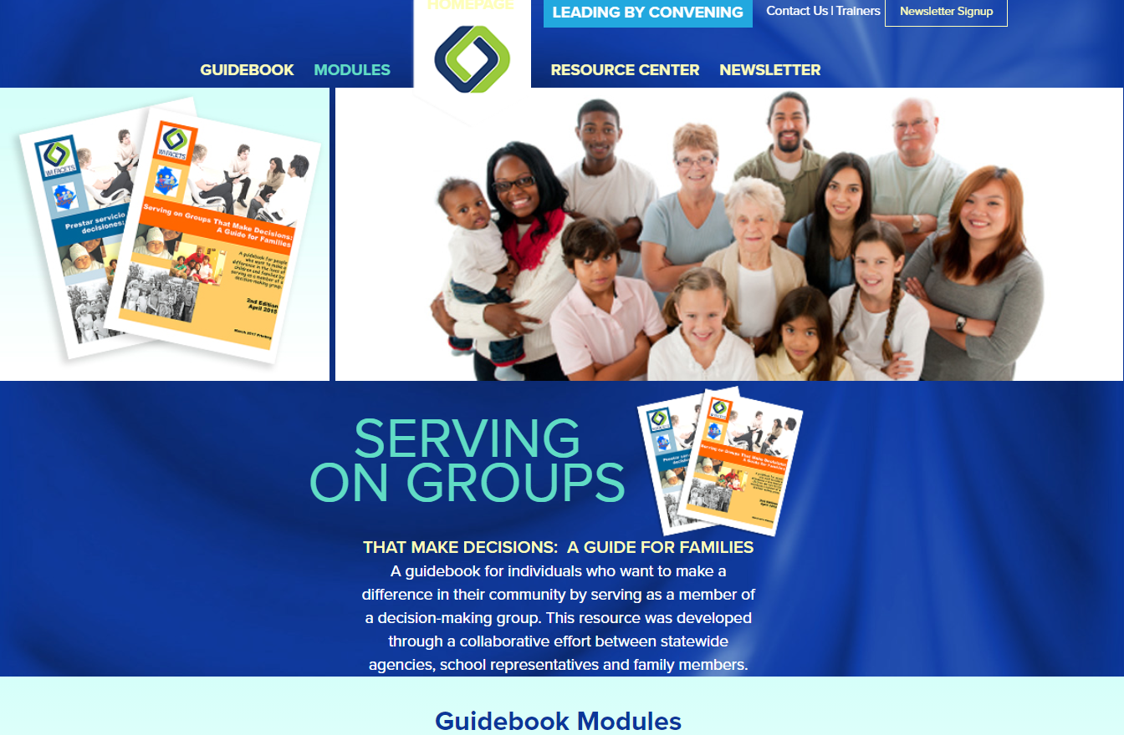
Serving on Groups Overview
Developed due to an identified need
Collaborative effort by stakeholders
Audience – parents, educators, students, others
www.servingongroups.org
Notes:
Slide #3: SOG Overview
Procedural Directions:
Show the slide. [CLICK] for animation.
Presenter Notes:
First, for those of you who weren’t with us for previous SOG webinars, I want to briefly tell you about Serving on Groups.
SOG was developed in response to an identified NEED.
WI FACETS found that it is not enough to just invite parents to join decision-making groups, but that they may need empowerment, info & and support in order to be more effective participants. This resource provides that for parents.
AND, the info is really intended to support anyone on those groups, not just parents.
And it applies to ALL types of dec-mkg grps, not just related to education, and not just in WI – but can be applied nationally.
WI FACETS developed the Serving on Groups Guidebook with funding from the WI DPI & US Dept of Ed/Office of SpEd Programs..
You’ll hear me refer to the resource as “the Guidebook” for short.
The research and review of this Guidebook was the result of work with a large group of stakeholders from across WI that included parents, educators, state agencies.
There is something for everyone in the Guidebook. It is a great intro for some, a welcome refresher for others, and a resource for all, including experts and mentors, so everyone can come to the table ready to serve.
The Guidebook and many related resources can be downloaded free from the SOG website. The link is on the screen.
I want to give a big promotion of the Online Learning platform for the Modules that is on this SOG website
[CLICK] Just click “Modules” at the top of the webpage to access all the Modules 24/7.
WI FACETS just updated this whole section – and it is really excellent! Be sure to check it out.
People can also order the hardcopy of the Guidebook from the site.

Slide 4


Section 7:
The Role of Families on Groups
Where do I start?
What do I need to know about my role?
What do I need to know about the group?
What ways might I represent the perspective of other families?
What ways might I share my family story?
Notes:
Slide #4: Intro Section 7
Procedural Directions:
Show the slide.
Presenter Notes:
Let’s get started with Section 7, the Role of Families on Groups.
One of your Handouts is the complete Section 7 from the Guidebook.
A particular emphasis today will be on the family representative role and ways to make sure all voices are heard and represented.
Often, families are not asked to serve on a decision-making group only to represent themselves and their family.
The reason they are often asked to join a group is really to give the perspective of other families in a similar situation.
But, that is not something that most parents are familiar doing.
So, how do we learn those skills and how do we turn our family story into a tool to make the changes we are looking for.
And, how can someone serving in the “family” representative role make sure that all voices are heard and represented.
I should mention that, the title of Section 7 is “The Role of Families on Groups,” so I will talk today about the “Family” representative role.
But, please know that this information can apply to anyone who is representing the values and opinions of others, more than just their own opinion, when they serve as a representative on a group.
So, for example, if you are an educator, asked to represent the voices of other educators on a decision-making group, such as on a school advisory council, etc., this information can also be very useful for you.

Slide 5

The Group
Learn about:
  Mission, Purpose, & History
  Style of leadership
  Priorities and goals
  Structure
  Decision-making process
Reminder…
  Review past meeting minutes
  Attend a meeting before joining
Notes:
Slide #5: The Group
Procedural Directions:
Show the slide.
Presenter Notes:
It is important to understand the group in which we are serving, or being asked to join.
Each group is unique in their mission, their leadership style, priorities and goals the group is working towards, how the group is structured (as, if it uses formal or informal processes), and how they make decisions (as, do they go by majority vote, or use consensus, etc).
Your time is valuable - so choose your opportunity wisely. You will want to find an opportunity that is meaningful to you.
To make sure your time is productive, consider a few points before agreeing to serve.
Review the group’s mission statement, purpose & Hx to see if the grp is working on issues that are impt to you. Find out the reason the grp was created in the 1st place.
Is the group formal or informal? Is there a president, vice-pres, secretary, and treasurer? If there is no designated leader, find out who organizes the meetings.
Find out the group’s expectation and description of member roles. Are there attendance requirements? Dues or Donation or Fundraising requirements? Do you have the time & necessary commitment level? Are you required to serve on additional committees?
Ask if meeting notes from the past few meetings are available for you to review. This will help you understand what the group has been doing most recently. These meeting minutes record what the group has talked about & also identifies any decisions that were made recently.
Ask to Visit a grp’s mtg before you officially commit to join. This will help you see the group dynamics.
You can interview someone currently serving on the grp.
(Jan’s Example – when I mentioned checking out Donations/ Fundraising responsibilities… When I was on the Board of the Autism Society of America, I was in the middle of a 4-year term, when all of a sudden the Board voted to require a $20,000 “give or get” requirement. Well, I was certainly not in any position to donate $20,000, so I thought I would have to quit. But, then I also thought that the agency needed money, so I decided I would try to see if I could “Get” $20,000 worth of donations. I actually was able to do that – thanks to a few donations from friends who had kids with autism, but also I got a large donation from the company that makes Lava Lamps (if any of you know what those are – very popular in the 60’s).
The point is, try to find out those requirements for donations & fundraising in advance if you get on a Board of Directors. … and, hope, they don’t change the rules midstream.)

Slide 6
The Group
Important to understand….
How the group’s work fits
into the work of the larger organization
The process and timeline for getting things done
Remember: Be patient and don’t give up!
Notes:
Slide #6: The Group
Procedural Directions:
Show the slide.
PRESENTER NOTE: *Slide contains animation. Click to make animation appear.
Presenter Notes:
It is also important to find out ahead of time how the group’s work fits into the larger organization.
Or, perhaps the group isn’t part of an organization at all, and maybe functions outside an evaluates or advises – so maybe the group wouldn’t look like the pie chart you see on the screen, but might look like a satellite separate from the larger organization.
Besides understanding how the group’s work fits into the work of the larger organization, it is also important to understand the process and timeline for considering and implementing the recommendations given by the group.
Sometimes we think we are going to join groups to make big changes quickly. Or, we join a group that only has an advisory function and isn’t actually able to make the decisions and put them into action.
By understanding what we are getting into, it manages our expectations and understand the timelines – so that we can understand that Things often don’t happen right away!
And we can be patient and not give up or leave the group.

Slide 7
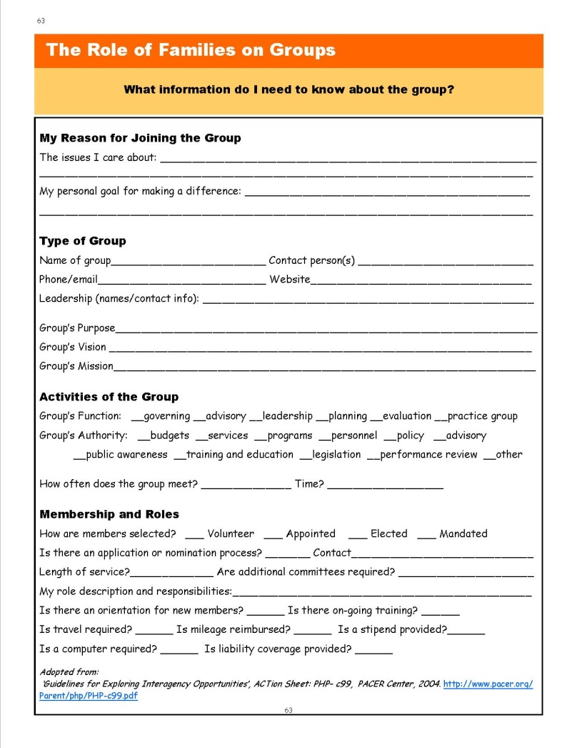
Resource
*Page 63:
What Information Do I Need to Know About the Group?
Uses:
Learning Tool
Reflection
Assessment
Mentorship
Notes:
Slide #7: Resource
Procedural Directions:
Show the slide.
Presenter Notes:
This is one of your handouts – it’s in your Section 7 handout, on page .63, titled “What Information Do I Need to Know About the Group?”
When you are considering joining a group or are new to a group…this tool is something that is very simple for you to use to help organize information about the group.
As someone new to a group, it can also be used to build an understanding about your purpose on the group, the structure of the group, & the processes the group uses.
As someone experienced on a group, it can be used to assess your own understanding of the group, as a resource for mentors and new members, or as an instrument to determine missing information about the group.
POLL#2: Where could you go to find info. about the group to complete the resource? (set for – Multiple Choice/Multiple Answers)
Ask the group leader
Ask the person who invited you to join,
visit the group’s website,
review the group’s bylaws (Answer is all of these)
Ask for past minutes

Slide 8

Your Role on the Group
  Connect with past representative
  Ask for a mentor
  Come prepared
  Ask for group’s written guidance
  Inquire about attendance support
Notes:
Slide #8: Your Role on the Group
Procedural Directions:
Show the slide.
Presenter Notes:
In order to learn your role as a family rep. on the grp, you are going to have to understand what your role & responsibility will be.
When other families can’t be physically in the mtg, they rely on Family Representatives to bring their interests & concerns to the discussion
The energy you spend learning new skills, preparing for & attending meetings will be worth it, especially when you begin to see results from your efforts.
There are a few things to do as you begin your new role.
Connect with a parent who served as the Family Rep before you to get an honest picture of your role.
Ask for a mentor in grp who can be a guide as you begin.
Always try to come to the mtg prepared. If the grp will be reviewing a draft doc at the mtg, be sure to read before mtg.
Find out if the group has by-laws or procedures that guide the way they operate. If so, ask for a copy of the most recent version & review them before you start w/the group.
Find out about attendance support. Support can meet a lot of different things that you might need in order to participate. You can ask what the process is for requesting reimbursement or a stipend. Especially if childcare is needed in order for you to participate, if you have out-of-pocket expenses, or if travel or overnight stays are required.
Jan’s example: I served on various advisory committees over the years. At the end of most of these meetings, people could fill out a form requesting reimbursement for their mileage and per diem expenses (per diem means a daily rate for things like food). The reimbursement check came a week or so after the meeting.
Jan’s EX: For other meetings I attended, some people needed the reimbursement for mileage & child care right away, so they asked for that before meeting. Sometimes they were given a gift card for gas and a check for their estimated child care expenses.
You have a handout, Fam Ldrshp Cklist Activity
As a parent takes on the role of Family Rep., or when you are representing others (maybe you are an educator representing other educators in a group), this is a great checklist to use.
Three areas to look at – are you clear on What the Role is? Do you Understand the Personal Costs? And Evaluate Your Expertise.
Consider completing this Checklist with view to the dec-mkg group you are on, or are considering joining
The Checklist answers may reveal that this is totally NOT the right time to take on more responsibility, but if only a few things are not checked, you know what skills you need to polish or things you have to clarify. The oppty for leadership and to use your own individual gifts and strengths is important and will provide the chance for you to make a difference in people’s lives.

Slide 9
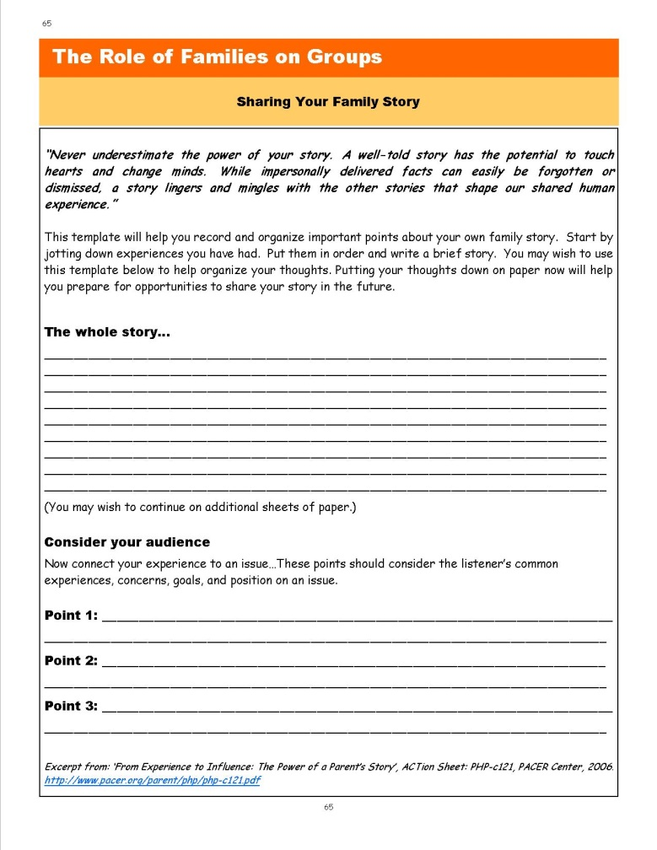
Resource
*Page 65:
Sharing Your Family Story
Your Family Story:
Who are you?
What brings you to the group?
What will YOU bring to the group?
Notes:
Slide #9: Resource
Procedural Directions:
Show the slide.
Presenter Notes:
Finally, when you join a grp, you may only have a few minutes or less to introd yourself. You want to make sure you plan your introduction carefully in advance – include a little about yourself, why you are here, and what YOU will bring to the group. It only takes a few secs to make a 1st impression. You want to make sure it is a good one..
HO- Sharing Your Family Story (Section 7, p.65, has a nice template to help you record/organize impt. points about your own family story.
You can see there is only a paragraph of space to share your whole story. It is impt to keep your intro short(1½-2 min) becz when you intro yourself, that is often all the time you will have.
In your intro, focus on the answers to these 3 Qs:
Who are you (relevant to the group)? If you are joining the grp as parent of a ch w/spec needs, you don’t want to use your whole intro to talk about your job, where you are from, or your hobbies; you want to focus on your role as a parent & perhaps share age & disability of your child
What brings you to the group? If you are joining to be a Family Rep & to share the voices of other families in situations similar to yours, is impt to share that
What will YOU bring to the group? This is where personal & prof. experience might be shared. If you are an accountant coming on a Bd, you might suggest you can help review financial policies or by serving on Audit Cmte, or as the Board Treasurer at some point. If you are an attorney, you might suggest that you are interested in serving on the Governance Committee.. If you love to plan parties/events, you could indicate your interest in serving on the Bd’s Fdrsg Cmte.
We all bring unique gifts and talents to the groups that we join.
This is where finding out about the grp ahead of time will help you because you are the expert on yourself & your interest, so being able to share some of the opportunities you found out about the group will help the grp find a good fit for you as well.
Jan’s EX: when I came on to the Board of Directors of the Autism Society of America (ASA) in 1991, here was my Family Story… Hi, I am Jan Serak. I am the parent of 2 sons – my older son, Ben, is 14 and has autism. I am the President of the Autism Society of WI currently, so I am here to, hopefully, represent the voice of many other parents of children & youth with autism and other of our members in WI. Also, I am the Executive Director of Wisconsin’s Parent Training & Information Center, WI FACETS, a nonprofit organization that supports parents of children with disabilities related to special education. I not only bring my knowledge about managing a nonprofit, but also my knowledge related to special education, civil rights, and legislative advocacy. I am honored to be here.

Slide 10

Best Ways to Represent Others
Welcome Input
  Create a brief survey
  Go where the families are
Be Accessible
  Attend meetings in the community
  Provide contact information
  Seek out and support involvement
Communicate
  Write and post summary reports
  Be the link between families and the group
Notes:
Slide #10: Best Ways to Represent Others
Procedural Directions:
Show the slide.
Presenter Notes:
So, at this point you might be thinking… how am I supposed to represent other people? I don’t always know what is best for my own family on these dec-mkg grps…much less represent the voices of other families in my comnty?
Family representatives on groups serve as liaisons to other families by providing them with info.they need to know. This information will help families participate and contribute in meaningful ways.
Family representatives on grps also help connect &share input & Qs from families to the orgnztns and people who need this information.
As a family rep., remember it is your job to represent the voice of MANY families, not just your own.
It is your role to seek out & support the involvement of families who are interested in and potentially affected by the group’s decisions.
These are some ways that you can get better at finding out other people’s interests & sharing them w/the grp you are on…
Welcome Input. Go where the families are. Be accessible,
EX, attend parent grp mtgs, comnity or school mtgs/events
You could have a separate business card w/your contact info.& role as a Family Rep avail – so families can call you.
Maybe set up a separate email for this purpose only.
2. Welcome input. If here are families that you haven’t been receiving any input from & want to rep better, you might need to reach out to them more directly. Some ideas are to:
Create a brief survey. Be mindful of confidentiality.
Plan a focus group mtg for anyone interested in a specific topic but provide info.in advance so people can prepare their thoughts.
Offer to visit with families in their home or neighborhood location.
3. Provide feedback to families so they can see the impact they made by providing summary reports about the group’s decisions & posting them in places like libraries, grocery stores, community centers, or on social media/Facebook.
Jan’s EXAMPLE: A great example of another way to provide feedback that I experienced was when I was on the WI Governor’s Task Force to develop the State Plan for Education.
Lisa Pugh, who was the state Director of the WI ARC at the time, was on the committee representing parents and students with disabilities.
After each meeting, she made a short video explaining the progress the committee was making. She sent it out widely to ARC members and many others so that families of students with disabilities and anyone else interested could be kept up to date and contact her with any ideas they might have.

Slide 11
Representing Other Families
Step 1: Identify your social circles.
Step 2: Identify additional social circles found in your community.
Step 3: How could you reach out to the families you are not connected with (outside of your social circles) in your community?
Notes:
Slide #11: Representing Other Families
Procedural Directions:
Show the slide.
Presenter Notes:
When you are representing families, it is important to first identify your own social circle. For example, you may know people from your son’s wrestling team, your daughter’s soccer team, your church, your exercise class that you go to, your child’s Special Olympics parent group, etc. Think of all the different people you know from all the different things that you do. Also think of all the people that the friends and family in your social circle are connected with.
After you have tried to map those out, think about your entire community and the social circles found there.
The question then becomes, how can you reach out to those families that are in your community, but outside of your social circle.
That involves some work and some building of connections and building of trust.
But it is important to make that leap so that you can reach families that are out there so that their voice can be heard and included in the family voices that you bring back to your group.

Slide 12
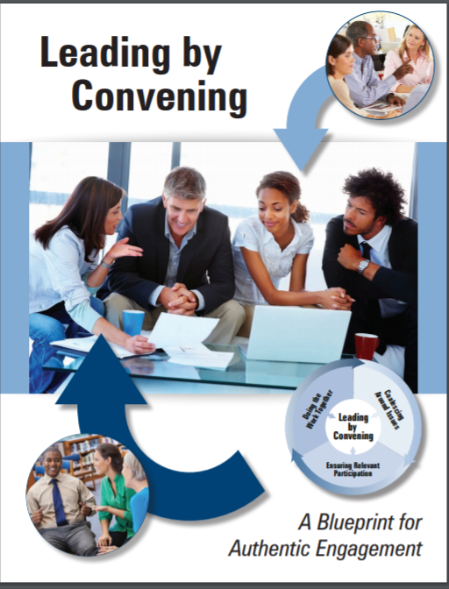
Leading by Convening
Four Simple Questions
  Who cares about this issue and why?
  What work is already underway separately?
  What shared work could unite us?
  How can we deepen our connection?
Engaging Everybody
  Core Team
  Key Participants & Advisors
  Extended Participants
  Dissemination Networks
https://servingongroups.org/leading-by-convening
Notes:
Slide #12: Leading by Convening
Procedural Directions:
Show the slide.
Link is “live”
Presenter Notes:
I want to share with you a great resource - Leading by Convening: A Blueprint for Authentic Engagement
Serving on Groups and Leading by Convening are considered "both sides of the coin."
LbC is a resource for reaching out to parents & others at the front end to find & invite anyone to the decision-making group that is important to the conversation & the work of the group- ie, getting the right people on the group
SOG is a resource for supporting people once they are on a group so they can be more effective members
Although it is not necessary to use both resources when serving on a group, it is highly recommended to utilize BOTH resources for producing the most positive and efficient outcomes when making decisions in a group setting.
We think LbC is such an important resource and a great companion piece to Serving on Groups – that the 2 resources share the same WI FACETS’ website.
LbC was developed by the IDEA Partnership, U.S. Dept. of Education/Office of Special Education Programs funding.
Over 100 stakeholders nationwide worked together to develop a “blueprint for authentic engagement”–a process for stkhldrs to work thru together to turn participants into partners & to move teams to deeper levels of collaboration.
The website link shown includes many resources. It has a .pdf copy of Leading by Convening – a great resource for you if you are convening a decision-making group. The link is also on the Resources slide that comes next.
We are not going to go in depth on LbC today;, but know that The National Center for Systemic Improvement took the Leading by Convening publication and developed 5 self-study modules to help states increase stakeholder participation and build active engagement in decision-making groups.
This website also has all 5 of these modules along with a bunch of nifty tools.. We strongly urge you to take the time to go thru these 5 modules! About 45 min. each with lots of tools to use.
This slide shows just 2 of the tools available in LbC to help people think through how to best organize a group on the front end………
4 Simple Questions Is a worksheet available in LbC
Who cares about the issue & why? These Qs let groups get beyond their personal or professional role to get a big picture of the issue in practice/reality
What work already underway? – recognizes the work of others; respecting the history that others have on the issue
What shared work could unite us? Relationships take time; shared activities make a start & lead to bigger oppties?
How can we deepen our connections? as, beyond just 1 single outreach, but how can you connect & support other already working on the issue & how can the group support your work
Engaging Everybody is another worksheet available in Lbc.
Impt to engage the full range of stakeholders – but for most issues, people may want to be involved but not all at the same level or time commitment.
Use the circles to send impt messages or invite certain participation\
Core Team; Key Partic; Extended partic; Dissemination networks -

Slide 13
Section 7 Resources
Leading by Convening
www.servingongroups.org/leading-by-convening
EPIC– Every Person Influences Children (video-20:26)
http://www.youtube.com/watch?v=BI4rqX_F69c
Advocacy in Action: A Guide to State Education Parent Advisory Councils
https://www.parentcenterhub.org/wp-content/uploads/repo_items/National_SEPAC_Guide_120218.pdf
Home and Community Positive Behavior Support Network (HCPBS)
https://hcpbs.org/
Tips for Recruiting Patients & Families to Serve in Advisory Roles
http://www.ipfcc.org/resources/Tips_For_Recruiting.pdf
Diverse Voices Matter: Improving Diversity in Patient & Family Advisory Councils
https://www.ipfcc.org/resources/Diverse-Voices-Matter.pdf
Notes:
Slide #13: Resources
Procedural Directions:
Show the slide.
Presenter Notes:
Finally, here are some of the resources for Section 7.
There is information on including parents and about parents serving on boards.
The first one, Leading by Convening, of course, we just mentioned.
In WI, parents of children with disabilities are important members of the State Superintendent’s Special Education Advisory Council. So, the 3rd resource - Advocacy in Action Guide – is a really good resource for someone thinking of serving on that group.
-------------------------------------------------------------------
Leading by Convening
www.servingongroups.org/leading-by-convening
EPIC– Every Person Influences Children (video-20:26)
http://www.youtube.com/watch?v=BI4rqX_F69c
Advocacy in Action: A Guide to State Education Parent Advisory Councils https://www.parentcenterhub.org/wp-content/uploads/repo_items/National_SEPAC_Guide_120218.pdf
Home and Community Positive Behavior Support Network (HCPBS) https://hcpbs.org/
Tips for Recruiting Patients & Families to Serve in Advisory Roles
http://www.ipfcc.org/resources/Tips_For_Recruiting.pdf
Diverse Voices Matter: Improving Diversity in Patient & Family Advisory Councils
https://www.ipfcc.org/resources/Diverse-Voices-Matter.pdf

Slide 14
Section 7 Resources
Guidelines for Exploring Interagency Opportunities ACTion Sheet http://www.pacer.org/Parent/php/PHP-c99.pdf
From Experience to Influence: The Power of a Parent’s Story ACTion Sheet http://www.pacer.org/parent/php/php-c121.pdf
Five Top Tips for Engaging Families in Advisory Roles: Advice from a Family Leader
https://www.lpfch.org/publication/five-top-tips-engaging-families-advisory-roles-advice-family-leader
National Association for Family, School, and Community Engagement https://nafsce.org/page/About
WI DPI Community of Practice Group on Assistive Technology https://dpi.wi.gov/sped/educators/consultation/assistive-technology/at-forward
Notes:
Slide #14: Resources
Procedural Directions:
Show the slide.
Presenter Notes:
Here are more resources related to Section 7.
I should point out the Ntl Assoc for Family, School, & Community Engagement resource – really has some great information on it.
Guidelines for Exploring Interagency Opportunities ACTion Sheet http://www.pacer.org/Parent/php/PHP-c99.pdf
From Experience to Influence: The Power of a Parent’s Story ACTion Sheet http://www.pacer.org/parent/php/php-c121.pdf
Five Top Tips for Engaging Families in Advisory Roles: Advice from a Family Leader
https://www.lpfch.org/publication/five-top-tips-engaging-families-advisory-roles-advice-family-leader
National Association for Family, School, and Community Engagement https://nafsce.org/page/About
WI DPI Community of Practice Group on Assistive Technology https://dpi.wi.gov/sped/educators/consultation/assistive-technology/at-forward

Slide 15

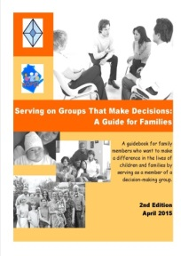
Section 8:
Skills for Serving on Groups
What skills will help me…
prepare for a meeting?
participate in a meeting?
follow-up after the meeting?
deal with conflict?
facilitate a meeting?
Notes:
Slide #15: Section 8-Skills for Serving on Groups
Procedural Directions:
Show the slide.
Presenter Notes:
We are now going to cover Section 8 –Skills for Serving on Groups.
One of your Handouts is Section 8 from the Guidebook.
Remember that the most effective teamwork starts with well-prepared members!
So, we are going to talk about the skills that are necessary for serving on groups. These include skills that will help when you are;
preparing for a meeting,
Participating in a mtg,
follow-up after the mtg,
We are also going to discuss Dealing with conflict & then also a little about how to facilitate a meeting
We’ll take a look at each one of these areas in more detail & provide tips & strategies to help you be the best group member that you can be.
For those of you who have been on the first 4 webinars, some of that information will be in this final Section also.

Slide 16
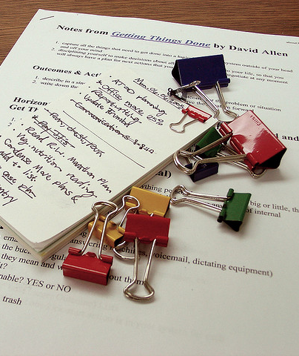
Prepare for a Meeting
Tips:
Keep a calendar
Read the agenda & additional items
Review past meeting minutes
Organize your thoughts
Keep learning
Notes:
Slide #16: Prepare for a Meeting
Procedural Directions:
Show the slide.
Presenter Notes:
The 1st skill that is impt is learning to Prepare for a meeting. Some tips for doing this are:
Keep a calendar. Where you record the mtg dates & times, including small grp mtgs or cmtee mtgs that may be scheduled in between regular mtgs of the whole grp You can also include due dates for review the materials for your meetings.
Read the agenda & all other items sent for the meeting. Always try to get the agenda ahead of time so you can prepare for the mtg. Even if there is no written agenda, you can ask the grp leader to list the major topics.
Review past mtg minutes - read the minutes through for accuracy & to make sure they accurately recorded all impt info. Sometimes if you took your own notes, you may find discrepancies. In many grps, you will have a chance to add/change something in the minutes if needed before the minutes are approved at the mtg.
Organize your thoughts before the mtg. Think about & write down your comments ahead of time so that you’ll be prepared to discuss the agenda items & addtl materials. Remember, you are an equal member of the group & it is impt for you to offer not only your thoughts, but also the ideas & perspectives of all those you represent.
Keep learning by researching items listed in the agenda & in the additional materials sent before the mtg – especially if it is something you are not that familiar with. Build an in-depth understanding of issues, the budgeting process, policy, etc. before the meeting.
A few good ways to find more info. are to:
Go online & research resources about the group’s topic, or maybe about things like how to prepare budgets, or read financial reports
Visit your library
Practice good listening skills & communication skills when you are getting ready for a meeting. Talk to other people on your group or other grps or other stakeholders– ask them how they prepare and where they find information about topics & issues you care about
Social media is a great place to look. Follow other groups that are similar to yours & doing related things, or local/state/ntl grps that are dealing with issues similar to those you care about. That way you can stay up-to-date on new developments in the field and make sure you are in the loop on what is current about your group’s issues.
.

Slide 17
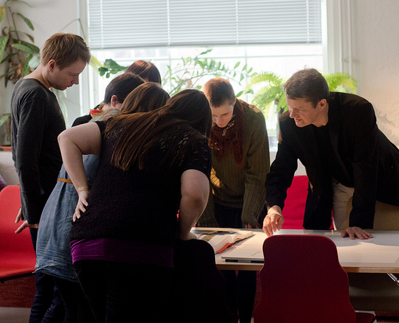
Participate in a Meeting
Attend all meetings
  If unable to attend:
    Let leader know ahead of time
    Make sure to get notes or meeting minutes
Take and keep notes
Learn the lingo
Try new roles
Be a mentor
Listen for understanding
Notes:
Slide #17: Participate in a Meeting
Procedural Directions:
Show the slide.
Presenter Notes:
So now you have done a lot of work in Step 1 to Prepare for your Meeting.
So, Step 2 is to Participate in the Meeting.
Participating a mtg can be difficult if you are not used to being part of a group (& sometimes even if you are used to it! )
When we are members of a group, it is important to participate & attend ALL mtgs. Find out if all mtgs are in-person or if there are alternative methods for partic. such as Zoom, Skype, conf. calls, GTM or other kind of online or virtual type of participation mode.
Attending meetings helps build relationships & your own understanding of what the group is about & what the group is trying to do. It shows a commitment to the group. It is hard to stay up to date on the group & what they are doing & being part of the dec-mkg process if you aren’t there.
If you can’t attend, be sure to let the leader know ahead of time & make sure to get the notes or mtg minutes as soon as possible for your review. If you can’t participate live, you might want to ask if the meeting can be recorded. Or, after the meeting, try to talk to someone who was there so you can really get an idea of what took place in the meeting.
When you do attend the meeting, make sure that you take your OWN NOTES (rather than just relying on the minutes).
That is because minutes often have minimal detail about the discussion & info that went into a final decision.
By taking your own notes, you’ll be able to do it in a way that is meaningful to you. And, if you need to look back for something that was discussed or decided, you’ll be able to find it. It will also help you check that mtg minutes are accurate & complete (include all impt things that were discussed)
Make sure you Learn the lingo that is used in the mtg. - like specific words, acronyms & abbreviations used. You can ask group if they have a “cheat sheet” or create your own as you go along. Any type of grp will have their own special vocabulary, & we know there are lots of acronyms in spec.ed.
Don’t get too comfortable in one role on your group. Think about Trying a new role in the group - like leading the discussion, recording the mtg minutes, or being the timekeeper.
Some groups use a rotating facilitator role so everyone has the opportunity to facilitate a mtg. This helps the group dynamics so 1 person doesn't dominate the leadrship of the group
Once you feel comfortable in your group, you may want to consider Being a mentor to new members.
Make sure that, during the meeting, that you Listen for understanding. When you do not understand what is being said, ask “What I think I hear you saying is…” which is also known as restating what you heard. Then ask, “Is that right?” This gives the speaker a chance to clarify and add more information, if needed.
POLL#3- In the mtgs in which you have participated, which of these strategies or other strategies have you used? (set for Multiple Choice/Multiple Answers)
Attend all meetings
Use Restatement to clarify
Take own notes
Learn acronyms/use cheat sheet
Mentor new group members
If there are any other strategies that you have used, feel free to share them in the Chat Box.

Slide 18

Follow-Up after a Meeting
Tips:
Refer to your notes
Stay organized
Use technology
Review written guidance
Reflect on what was learned
Connect with mentor
Review data
Keep learning
Notes:
Slide #18: Follow-up After a Meeting
Procedural Directions:
Show the slide.
Presenter Notes:
So. when the mtg is over, that doesn’t mean the work is done.
After a mtg, there will typically be materials to read & activities between meetings. Some groups have sub-groups that meet to carry out a specific task for the group.
A great habit to get into is to do a follow-up after the mtg. You can do this by:
Referring to your notes. Either during or after the mtg, make a list of follow-up items & Qs to ask. This will help you keep track of impt. Info. to refer to after the meeting.
Make sure that you Stay organized. Use a binder to store all material so it is easier to locate info. during the mtg. Make a separate labeled divider for: contacts, by-laws, ground rules, agendas, meeting notes, reports, projects, and reference materials.
You can also Use technology. Electronic files that are sent to you ahead of a mtg can be stored in a folder on your laptop for easy access. If you have a laptop/tablet or use the notes area of your mobile phone, you can type notes during the meeting and add them to that meeting folder, so it is easier to search them later
After the mtg, it is impt to check back on the grp’s written guidance, as grp’s bylaws, procedures,
Reflect on what you learned & what was discussed in the mtg
Connect with a mentor to debrief the mtg. & ask Qs.
Review data. Take time to study the info & understand what the group is trying to do.
Keep learning by researching the topics in other areas, states, organizations, and the like. Great ideas might come from looking at the work of others.
POLL#4- In the mtgs in which you have participated, which of these strategies have you used to follow-up your meeting? (Mult.Choice/Mult.Answers)
Use binder/computer files to organize meeting materials
Review written guidance (as, bylaws)
Debrief with another group member
Review data shared in meeting
Do more research on the topics discussed
If there are any other strategies that you have used, please share them in the Chat or Q Box.

Slide 19

Dealing with Conflict
Tips:
Keep an open mind
Use “I” statements
Don’t take things personally
Ask questions
Stay focused on the topic
Focus on solutions
Take a break
Remember the group’s purpose
Notes:
Slide #19: Dealing with Conflict
Procedural Directions:
Show the slide.
Presenter Notes:
Not all meetings go smoothly. Sometimes you have to deal with conflict.
Conflict is a natural part of grp dynamics; but it can be very complex & hard to deal with
It is impt to Try to respect individual differences. But it’s also impt to avoid becoming too entrenched in a fixed position. We usually can’t control other people’s behavior; but we can control our own..
Keep an open mind - You might learn something or increase your understanding of another’s point of view.
Use “I” statements, not “you” statements. Instead of saying, “YOU bring up the same dumb idea every time… You could say, “I feel like we have discussed this option in the past & I would like to hear some new ideas or options people have”
Don't take things personally. If you feel like grp should vote 1 way on an issue and other members think the grp should vote a different way, it doesn’t mean they think you are stupid or a bad person or anything negative about you, you just have a different opinion. Try to see the person and not the position that they are taking.
Ask questions – Stay focused on the facts. If someone takes a position that you don’t agree with ask Qs & find out the facts –Ask-Who? What? When? And Why? How much? Asking those kinds of Qs will really help flush out those answers.
Stay focused on the topic-Refer back to the agenda as a reminder. That is why it is so impt to have a mtg agenda that describes what items the grp is going to talk about in the mtg. That way, if people get off topic & into the weeds, you can say, “We are on Item #4 right now, this conversation is unrelated we need to turn back & focus on that topic.”
Focus on solutions. If you provide an issue or concern, try to offer a solution or potential options. If your grp is planning an event on a Sat. morning, for example, don’t just say, I think we should have it on Sat afternoon,” instead also say, “Because… and then give your reasons and backup for why you think it should be better at a different time.
If the conflict is really escalating, make sure to Take a break – If you feel overwhelmed, excuse yourself for a few minutes. Or, suggest the whole group take a break. Sometimes, stepping away from the situation a few minutes gives everyone an oppty to calm down & return their focus back to getting a good outcome.
Remember the grp’s purpose - its mission & vision statement - .keep that at the center of the conversation.
Activity on Conflict Management Styles
You have a HO – you can do this one on your own at home. This Activity is to help you become aware of your own conflict management style. If you do this with all the members in a group that you are on, it will also help everyone know the conflict management styles of others in the group so as to better communicate together.
We each have our own way of dealing with conflict. The techniques we use are based on many variables such as our basic underlying temperament, our personality, our environment and where we are in our professional career.
However, by and large there are five major styles of conflict management techniques in our tool box. In order to address conflict we draw from a collaborating, competing, avoiding, harmonizing or compromising style of management. None of these strategies is superior in and of itself. How effective they are depends on the context in which they are used.
In this Activity, just answer each statement for dealing with a conflict on a scale of 1 Rarely to 4 Always as to how likely you are to use these different strategies for dealing with a conflict.

Slide 20

Resolving Conflict
Tips:
Pay attention to interests
Listen first; talk second
Good relationships are a priority
Keep people and problems separate
Set out the facts
Explore options together
Notes:
Slide #20: Resolving Conflict
Procedural Directions:
Show the slide.
Presenter Notes:
Some addtl tips for Resolving Conflict are on this slide…
Pay attention to the interests that are being presented: By listening carefully you'll most-likely understand what interest underlies what the person is saying is his or her position.
Maybe the person is against voting to spend more money on one program becz they think money will be take away from a program that is more impt to them
Realy Listen first; and talk second: To solve a problem effectively you have to understand where the other person is coming from before defending your own position.
Make sure that maintaining good relationships are the first priority: As far as possible, make sure that you treat the other person/s calmly & that you try to build mutual respect. Do your best to be courteous to one another & remain constructive under pressure.
Keep people & problems separate: Recognize that often the other person is not just "being difficult" – real & valid differences can lie behind conflictive positions. By separating the problem from the person, real issues can be debated without damaging working relationships.
Set out the "Facts": Agree & establish the objective, observable elements that will have an impact on the decision. If we know it is a fact, for EX, there are 100 kids that are hungry every day in our school district, then that # is a fact that will be central to the grp’s discussion.
Explore options together: Be open to the idea that a third position may exist, or a 4th, 5th, ,or 6th.. And that your grp hasn’t found it yet – but working together, you may be able to get to the idea jointly. Oftentimes, your grp just hasn’t thought of all possible solutions yet.
Managed in the wrong way, real and legitimate differences between people can quickly spiral out of control, resulting in situations where cooperation breaks down and the group's mission is threatened.
To calm these situations down, it helps to take a positive approach to conflict resltn, where discussion is courteous & non-confrontational, & the focus is on issues rather than on individuals. If this is done, then, as long as people listen carefully & explore facts, issues & possible solutions properly, conflict can often be resolved effectively.

Slide 21
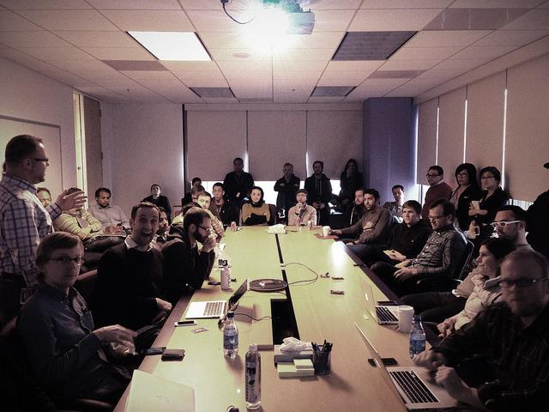


Facilitate a Meeting
Common strategies for good facilitation:
  Makes everyone feel comfortable, welcomed, and valued
  Encourages participation
  Prevents and manages conflict
  Listens and observes
  Clarifies group discussions
  Supports quality decisions
  Ensures outcome-based meetings
  Recognizes and appreciates contribution
Notes:
Slide #21: Facilitate a Meeting
Procedural Directions:
Show the slide.
Presenter Notes:
The next SKILL that is important to learn, as you grow in your group membership, is to serve in the role of FACILITATOR for your grp.
Hopefully, family members thru this SOG training will feel comfortable facilitating a meeting.
An effective meeting starts with a good facilitator. To facilitate a mtg, there are some common strategies good facilitators have:
They try to make everyone feel comfortable & valued by allowing time for 'small talk', thanking people for their participation, & using open body language (like uncrossed arms, leaning forward).
They encourage participation by all members by using open-ended Qs, dividing into small groups, using flip charts & handouts to make sure everyone’s ideas are heard, shared with the whole grp, and considered..
A good facilitator prevents or manages conflict by using team-building activities, setting ground rules (& referring back to the grd rules), drawing attention to things that everyone agrees on instead of focusing on the disagreements. The facilitator might say, “OK That’s good, I am hearing that we all agree on X, Y, & Z, and how do we focus on those areas of agreement to grow them?”
They actively listen & observe the others in the group by scanning reactions (both verbal & body language) to comments or issues.
They clarify group discussions by summarizing and rephrasing what was said. They may use the phrase “I hear that….”the Fundrsg Cmte thinks we should do X, Y, & Z. By rephrasing like that, they are offering oppty for clarification by the whole grp
They also support quality decisions being made by reminding the group of the decision deadlines, reviewing the criteria & supporting info. & polling the group before major decisions to avoid surprises.
They make sure the meetings stay on track and the group is getting done what needs to be done by keeping the group members focused, recordg decisions,& developg an action plan.
Finally, they recognize and express appreciation for member contribution to the work of the group and participation during meetings and activities. They really want to take time to recognize grp members – take the time to say thank you and congrats for your work today.

Slide 22
Listening Awareness Inventory
Listening is one of the most important keys to communication & understanding others.
Rate: 4 Almost Always; 3 Usually; 2 Seldom; 1 Never
Do you let people finish what they are trying to say before you speak?
If the person hesitates, do you try to encourage him/her…rather than start your reply?
Do you withhold judgement about the person’s idea until he/she has finished?
Can you listen fully even if you think you know what the person is about to say?
Can you listen non-judgmentally even if you do not like the person who’s talking?
Notes:
Slide #22: Listening Awareness Inventory
Procedural Directions:
Show the slide.
Presenter Notes:
As we just learned, one of the great skills of a good group facilitator is Listening.
Listening is one of the most impt keys to communication & understanding others.
I am going to have you all do a short Listening Awareness Inventory to see how you think that you are doing in the Listening area.
You are going to rate yourself 1-4 on 10 questions & then add up your score.
The ratings are: 4 Almost Always; 3 Usually; 2 Seldom; and 1 Never
1. Do you let people finish what they are trying to say before you speak?
2. If the person hesitates, do you try to encourage him/her… rather than start your reply?
3. Do you withhold judgement about the person’s idea until he/she has finished?
4. Can you listen fully even though you think you know what he/she is about to say?
Continue inventory questions on next slide…

Slide 23
Listening Awareness Inventory
Rate: 4 Almost Always; 3 Usually; 2 Seldom; 1 Never
6. Do you stop what you’re doing and give full attention when listening?
7. Do you give the person appropriate head nods, and non-verbals to indicate that you are listening?
8. Do you listen fully regardless of the speaker’s manner of speaking? (i.e. grammar, accent, choice of words, etc.)
9. Do you question the person to clarify his/her ideas more fully?
10. Do you restate/paraphrase what is said and ask if you got it right?
Total Score? 36-40; 30-35; 26-29; 25 or <
Notes:
Slide #23: Listening Awareness Inventory
Procedural Directions:
Show the slide.
Presenter Notes:
Inventory continued…
5. Can you listen non-judgmentally even if you do not like the person who’s talking?
6. Do you stop what you’re doing and give full attention when listening?
7. Do you give the person appropriate head nods, and non-verbals to indicate that you are listening?
8. Do you listen fully regardless of the speaker’s manner of speaking? (i.e. grammar, accent, choice of words, etc.)
9. Do you question the person to clarify his/her ideas more fully?
10. Do you restate/paraphrase what is said and ask if you got it right?
POLL #5 - Now see how you are doing – add up your points…
36-40 Points - Outstanding! Truly attentive and trying to listen. Probably have the reputation of being a good listener.
30-35 Points - Very good. With some effort, you could move into the upper range. Probably need to put more effort into attention and judgmental evaluation.
26-29 Points - Need work. Identify your lowest self-ratings and ask why you see yourself that way. Does this interfere with relationships? What would the pay-off be if you could improve?
25 Points or below –Not great. What would you gain if you could answer each question more positively?
If you are truly oriented toward becoming all that you can be, go back and try this one on for size:
Give this assessment to someone who knows you well (parent/sibling/friend/confidant) and ask them to give you feedback on each question in terms of how they observe your listening techniques.
Accept this feedback without reading it defensively. It may be a learning experience for both of you.

Slide 24
Section 8 Resources
Meeting Preparation: Lead Effective Meetings (video-6:24)
https://www.youtube.com/watch?v=itdYBXrJm-8
Meeting Facilitation Tips: How to Facilitate Your 1st Meeting (video-6:07) https://www.youtube.com/watch?v=oPZJQ-Mhwq0
Applying Results-Based Facilitation in Virtual Settings (Annie E. Casey Foundation) ) https://www.aecf.org/blog/applying-results-based-facilitation-skills-in-virtual-meetings
Virtual Meetings Etiquette-Do’s & Don’ts (video-7:56) https://www.youtube.com/watch?v=HYUVXQfaVp0
Developing Facilitation Skills Toolkit
http://ctb.ku.edu/en/tablecontents/sub_section_main_1154.aspx
Planning and Structuring Effective Meetings - Skills You Need http://www.skillsyouneed.com/ips/meetings.html
Forming, Storming, Norming, and Performing: Model for Nurturing a Team to High Performance (incl. video-1:58) http://www.mindtools.com/pages/article/newLDR_86.htm
Notes:
Slide #24: Resources
Procedural Directions:
Show the slide.
Presenter Notes:
Here are some of the Section 8 resources, including how to structure effective meetings and how to lead effective meetings.
So many groups meet virtually lately – so the video on Virtual Meetings Etiquette is a good one.
----------------------------------------------------------------------------------------
Meeting Preparation: Lead Effective Meetings (video-6:24)
https://www.youtube.com/watch?v=itdYBXrJm-8
Meeting Facilitation Tips: How to Facilitate Your 1st Meeting (video-6:07) https://www.youtube.com/watch?v=oPZJQ-Mhwq0
Applying Results-Based Facilitation in Virtual Settings (Annie E. Casey Foundation) ) https://www.aecf.org/blog/applying-results-based-facilitation-skills-in-virtual-meetings
Virtual Meetings Etiquette-Do’s & Don’ts (video-7:56) https://www.youtube.com/watch?v=HYUVXQfaVp0
Developing Facilitation Skills Toolkit
http://ctb.ku.edu/en/tablecontents/sub_section_main_1154.aspx
Planning and Structuring Effective Meetings - Skills You Need http://www.skillsyouneed.com/ips/meetings.html
Forming, Storming, Norming, and Performing: Model for Nurturing a Team to High Performance (incl. video-1:58) http://www.mindtools.com/pages/article/newLDR_86.htm

Slide 25
Section 8 Resources
Conflict Resolution: Using the Interest-based Rational Approach (incl. video-2:57) http://www.mindtools.com/pages/article/newLDR_81.htm
When Conflict Arises: Working with Emotion (video-16:21)
https://www.wsems.us/multimedia/videos/when-conflict-arises/
Handling Disagreements Productively http://parents-teachers.com/lib/Disagreements_Between_Parents_And_Teachers_-_Handling_Them_Productively/
The Big Bang Theory on Active Listening (video-1:55) https://www.youtube.com/watch?v=3_dAkDsBQyk
5 Ways to Listen Better(TED Talk video-7:51) https://www.youtube.com/watch?v=cSohjlYQI2A
Listening Skills (video-7:48) https://www.youtube.com/watch?v=B8EJVcRJSXo
Communicate - Paraphrasing (video-3:42) https://www.youtube.com/watch?v=5JL2iizK2c0
Notes:
Slide #25: Resources
Procedural Directions:
Show the slide.
Presenter Notes:
Here are some additional resources – include some good resources on active listening and what to do if conflict arises in your group.
The 2nd on this list, Working with Emotion, is a great, short video produced by the WI Special Education Mediation System.
I love the 2 short videos on Listening Skills and Paraphrasing.
------------------------------------------------------------------------------------
Conflict Resolution: Using the Interest-based Rational Approach (incl. video-2:57) http://www.mindtools.com/pages/article/newLDR_81.htm
When Conflict Arises: Working with Emotion (video-16:21)
https://www.wsems.us/multimedia/videos/when-conflict-arises/
Handling Disagreements Productively http://parents-teachers.com/lib/Disagreements_Between_Parents_And_Teachers_-_Handling_Them_Productively/
The Big Bang Theory on Active Listening (video-1:55) https://www.youtube.com/watch?v=3_dAkDsBQyk
5 Ways to Listen Better(TED Talk video-7:51) https://www.youtube.com/watch?v=cSohjlYQI2A
Listening Skills (video-7:48) https://www.youtube.com/watch?v=B8EJVcRJSXo
Communicate - Paraphrasing (video-3:42) https://www.youtube.com/watch?v=5JL2iizK2c0

Slide 26

Where to Go From Here?
  Sections 1 – 8. Contact Lori Karcher for recordings and handouts: lkarcher@wifacets.org
  or 877-374-0511
  -------------------------------------------------------------------------
  Register: http://wifacets.org/events
Disclaimer. This publication was produced by WI FACETS with funding from the WI Dept. of Public Instruction & U.S. Dept.of Education, Office of Special Education Programs. The views expressed herein do not necessarily represent the positions or policies of these 3 agencies. No official endorsement by these agencies of any product, commodity, service, or enterprise mentioned in this resource is intended or should be inferred.
Notes:
Presenter Notes:
Slide 38. Where to go from here?
Show slide.
Presenter Notes:
So, where do you go from here?
I want to remind you about the SOG website – where you can find the online learning platform for all 8 SOG Sections 24/7.
And remember, all 5 webinars in this series were recorded, you can get the recording links from WI FACETS.
And, you can go to the WI FACETS website and register for more webinars.

Slide 27
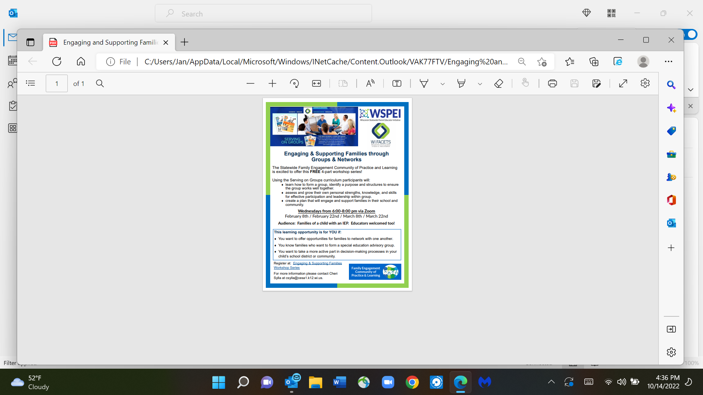
csylla@cesa1.k12.wi.us
Notes:
Presenter Notes:
Before we end today, I just want to give a “heads up” plug for this fantastic upcoming 4-part workshop series.
These 4 workshops will dive deeper into the Serving on Groups guidebook to make this resource even more relevant for your advocacy journey.
This FREE series is co-sponsored by WI FACETS and WSPEI (WI Statewide Parent-Educator Initiative).
The series will take place on 4 Wednesdays in a row, starting Feb. 8th Each session is from 6-8 pm via Zoom. It is hoped that you can commit to attending all 4 sessions in the series.
Contact Cheri Sylla – email on the screen – to register.

Slide 28
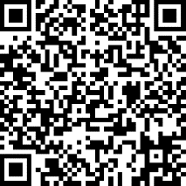
Thank you!
Please complete the evaluation!
https://www.surveymonkey.com/r/DR82XPS
Notes:
Slide #30: Evaluation
Procedural Directions:
Share info from presenter notes.
Presenter Notes:
Your feedback is very important to us so please complete the evaluation that will be emailed to you today after the webinar.
Or, if you can do the evaluation right now, just use the QR code on the screen, or the link in the Chat Box; or, it will be emailed to you later today.
Words to remember: “Leaders are not born ~ they rise out of a person’s passion for how they want the world to be”.
We are going to finish up with 3 quick polls.
Poll(#6): Do you think this workshop has been relevant for your needs? □ Very definitely □ Definitely □ In some ways □ A little bit
Poll (#7): Do you think this workshop was of high quality? □ 4 Excellent □ 3 Very Good □ 2 Good □ 1 OK
Words to remember: “Leaders are not born ~ they rise out of a person’s passion for how they want the world to be”.
Thanks so much for joining us today.
Have a great rest of the day!
----------------------------------------------------------------------------------------
WEBINAR LOGISTICS (JUST FOR PRESENTER)”
Click the STOP RECORDING.’” Button.
To end the webinar for all, go to “File” in the top row and click “Exit - End Webinar”.
Then in box that pops up that says “Are you sure you want to end the webinar for everyone?”, click YES.
Now, go to the directions for what to do after a webinar – ie, about downloading the recording and attaching it to the 2 follow-up emails within 2 hours.

