Slide 1
WSEMS y las opciones de resolución de disputas
Nelsinia Ramos, WI FACETS
Notes:
COURTNEY SLIDE
-------------------------------------------------------------------------------------------
Nuestro seminario web de hoy es Sistema de mediación de educación especial de Wisconsin y opciones de resolución de disputas.
Buenas tardes, soy Courtney Salzer, Directora Ejecutiva de WI FACETS y socia de los padres en el proyecto del Sistema de Mediación de Educación Especial de Wisconsin. Conmigo hoy está Nissan Bar-Lev, Director de Educación Especial para CESA 7 y socio escolar en el proyecto del Sistema de Mediación de Educación Especial de Wisconsin.
Nos gustaría darle la bienvenida a nuestra presentación sobre las opciones de resolución de disputas disponibles para los padres y las escuelas.
Sabemos que a veces surgen problemas/conflictos/disputas relacionados con la planificación o implementación de IEP para niños con necesidades especiales
El Sistema de Mediación de Educación Especial de WI ("WSEMS" para abreviar) ha estado ayudando a los padres de niños con discapacidades y las escuelas a resolver estas disputas desde 1996.
Esta presentación le proporcionará: (1) información sobre el WSEMS y las opciones gratuitas para la resolución temprana de disputas que están disponibles a través de nuestro Sistema, (2) información sobre cómo acceder a estas opciones y (3) también información sobre los resultados de el Sistema en los últimos 20 años.
Our webinar today is Wisconsin Special Education Mediation System & Dispute Resolution Options.
Good Afternoon, I’m Courtney Salzer, Executive Director of WI FACETS and parent partner on the Wisconsin Special Education Mediation System project. With me today is Nissan Bar-Lev, Director of Special Education for CESA 7 and school partner on the Wisconsin Special Education Mediation System project.
We would like to welcome you to our presentation on the Dispute Resolution Options available to parents and schools.
We know that Issues/conflicts/disputes sometimes arise related to planning or implementing IEPs for children with special needs
The WI Special Education Mediation System (“WSEMS” for short) has been helping parents of children with disabilities and schools resolve these disputes since 1996.
This presentation will provide you with: (1) information about the WSEMS & the free options for early dispute resolution that are available through our System, (2) information about how to access these options, and (3) also information about the results of the System over the past 20 years.

Slide 2
Introducción al WSEMS
Financiado por WDPI desde 1996
Sistema ejemplar reconocido a nivel nacional
Equipo asociado:
Courtney Salzer, WI FACETS Directora Ejecutiva
Nissan Bar-Lev, Director de Ed. Especial CESA 7
Gia Pionek, Socia de Mediación, Administradora del Sistema y Coordinador de Admisiones
Coordinadora de Alcance Latino
Nelsinia Ramos, WI FACETS
Sistema diseñado por las partes interesadas
Notes:
DIAPOSITIVA NISSAN
Gracias Courtney, Buenas tardes a todos. Como mencionó Courtney, ahora describiremos el sistema WSEMS.
El WI Spec.Ed. Mediation System (o WSEMS) ha sido financiado por WI DPI con una subvención discrecional de IDEA a CESA 7 desde 1996.
Durante todos estos años, los objetivos de esta subvención han sido:
administrar el WSEMS en todo el estado: lo que significa brindar opciones para la resolución de disputas a los padres de SwD y las escuelas en todo el estado.
para proporcionar una lista de neutrales para ayudar en la resolución de estas disputas
para proporcionar capacitación y divulgación sobre el Sistema, tal como lo estamos haciendo hoy.
recopilar datos longitudinales para la evaluación continua del Sistema.
WSEMS es un sistema único que ha sido reconocido a nivel nacional por una agencia del Departamento de Educación de los EE. UU. (CADRE) como 1 de solo 4 sistemas estatales que se consideraron extremadamente efectivos en su uso y resultados. WSEMS fue seleccionado especialmente por nuestra alta tasa de acuerdo y la participación exitosa de las partes interesadas.
Nuestro sistema fue diseñado por un grupo de 17 miembros de partes interesadas clave en 1996 (la mitad representando grupos de padres y la mitad de grupos escolares). El Consejo de Partes Interesadas de WSEMS todavía existe hoy y continúa sirviendo como un organismo consultivo colectivo para el Sistema.
Nuestro Sistema también es único a nivel nacional porque está dirigido por un equipo que modela la asociación y brinda supervisión al Sistema e incluye un socio escolar, ese soy yo, Director de Educación Especial para CESA 7:
– Represento la perspectiva de la escuela en nuestro equipo asociado y soy una de las fundadoras de WSEMS junto con Courtney Salzer, directora ejecutiva de WI FACETS, quien es madre de dos niños con discapacidades y representa la perspectiva de los padres en el equipo.
Gia Pionik, representa la perspectiva de una experta en resolución de disputas, Gia es mediadora, y también es -
el administrador del sistema y el coordinador de admisión. Cuando llama a WSEMS, ella es la persona con la que habla sobre sus problemas, explica lo que implica la mediación o la facilitación y asigna los casos a los mediadores y facilitadores.
Nelsinia Ramos, madre y directora asociada de WI FACETS. Nelsinia es la Coordinadora de Alcance Multicultural.
Además de la alta tasa de acuerdo y la intensa participación de las partes interesadas en las que el WSEMS fue reconocido a nivel nacional, Wisconsin también fue
uno de los primeros estados en brindar facilitación del IEP y facilitación neutral para las reuniones de resolución, y
Wisconsin estableció prácticas de mejora continua de la calidad en nuestro sistema, incluidas encuestas a los participantes, capacitación continua para la lista y comentarios de nuestras partes interesadas
NISSAN SLIDE
Thank you Courtney, Good afternoon everyone. As Courtney mentioned, we will now describe the WSEMS system.
The WI Spec.Ed. Mediation System (or WSEMS) has been funded by the WI DPI with an IDEA discretionary grant to CESA 7 since 1996.
For all of these years, the goals of this grant have been:
to administer the WSEMS throughout the state – Meaning to provide options for dispute resolutions to parents of SwD and schools throughout the state.
to provide a roster of neutrals to assist in the resolution of these disputes
to provide training and outreach about the System – just like we are doing today.
to collect longitudinal data for ongoing evaluation of the System.
WSEMS is a unique system that has been nationally - recognized by a U.S Department of Education agency (CADRE) as 1 of just 4 state systems that were considered extremely effective in its usage and outcomes. WSEMS was selected especially because of our high agreement rate and successful involvement of stakeholders.
Our System was designed by a 17-member group of key stakeholders in 1996 (1/2 representing parent groups & ½ school groups). The WSEMS Stakeholders’ Council still exists today and continues to serve as a collective advisory body for the System.
Our System is also unique nationally because it is led by a team that models partnership and provides oversight to the System and includes a school partner, that’s me, Special Education Director for CESA 7:
– I represents the school perspective on our partner team and I am one of the founders of the WSEMS along with Courtney Salzer, WI FACETS’ Executive Director, who is the parent of two children with disabilities and represents the parent perspective on the team
Gia Pionik, represents the perspective of a dispute resolution expertise, Gia is a Mediator, and she is also -
the System Administrator & Intake Coordinator. When you call WSEMS, she is the person who you speak with about your issues, she explains what is involved with mediation or facilitation, and assigns cases to the mediators & facilitators.
Nelsinia Ramos, a parent & Associate Director of WI FACETS. Nelsinia is the Multicultural Outreach Coordinator.
Besides the high agreement rate and intense stakeholders involvement in which the WSEMS was nationally recognized, Wisconsin also was
one of the first states to provide IEP facilitation and neutral facilitation for resolution meetings, and
Wisconsin established continuous quality improvement practices to our system, including participant surveys, ongoing training for the roster, and feedback from our stakeholders

Slide 3
Opciones de resolución de disputas
Notes:
DIAPOSITIVA NISSAN
El diagrama muestra todas las opciones que se pueden utilizar para resolver disputas relacionadas con la educación especial entre los padres de SwD y las escuelas.
Con las 4 opciones enumeradas en las flechas azul oscuro, los padres y las escuelas tendrán control sobre el resultado mientras trabajan juntos para resolver los problemas. Esto se llama autodeterminación. Las diapositivas de color azul más claro muestran procesos en los que otra persona tiene el control para tomar decisiones.
La reunión informal (que es la primera flecha a la izquierda) no es un proceso proporcionado a través de WSEMS. Es simplemente una reunión recomendada entre padres/maestro de salón, director o director de educación especial. Si bien se puede usar en cualquier momento, es especialmente efectivo si se usa temprano en la relación entre los padres y la escuela.
Como mencionamos anteriormente, las otras tres flechas azul oscuro están disponibles a través del sistema WSEMS: Facilitación del IEP, Mediación y Proceso de resolución (a veces llamado Reunión de resolución). En los tres, un mediador o facilitador imparcial de WSEMS puede ayudar a los padres y las escuelas a trabajar juntos para llegar a un acuerdo que satisfaga las necesidades educativas del estudiante.
En breve describiremos cada una de estas 3 opciones con más detalles.
Un denominador común para todas estas tres opciones de WSEMS. Todos ellos:
Comience con la admisión de casos por parte de Gia
son voluntarios
Son gratis
.
A medida que avanza de izquierda a derecha en este diagrama, las flechas azules claras indican procesos que están disponibles en Wisconsin pero no a través de WSEMS y donde el control tanto del proceso como del resultado comienza a pasar de los participantes a otra persona. Por ejemplo, una queja de IDEA será decidida por el personal de WDPI, el debido proceso por un juez de derecho administrativo y el litigio por un juez o jurado.
NISSAN SLIDE
The diagram shows all the options that can be used to resolve disputes related to special education between parents of SwD and schools.
With all 4 options listed on the dark blue arrows, parents and schools will have control over the outcome as they are working together to solve the issues. This is called self-determination. The lighter blue slides show processes where someone else has the control to make the decisions
The informal meeting (which is the first arrow on the left) is not a process provided thru WSEMS. It is simply a recommended meeting between parents/ classroom teacher, principal or special education director. While it can be used at any time, it is especially effective if used early in the relationship between the parent and the school.
As we mentioned earlier, the other three dark blue arrows are all available through the WSEMS system – IEP Facilitation, Mediation and the Resolution Process (sometimes called Resolution Meeting). In all three, a WSEMS impartial mediator or facilitator can help the parents and schools work together to reach an agreement that meets the educational needs of the student.
We will shortly describe each of these 3 options in more details
A common denominator to all these three WSEMS options,. They all:
Start with case intake by Gia
Are voluntary
Are free
.
As you move from left to right on this diagram, the light blue aarrows indicate processes that are available in Wisconsin but not through WSEMS and where the control of both the process and the outcome begins to shift away from the participants to someone else. For example, an IDEA complaint will be decided by WDPI staff, due process by an administrative law judge, and litigation by a judge or jury.

Slide 4
WSEMS
Proceso de la toma de casos
Solicitud de información recibida
Facilitación de IEP
A elección de las partes
(autodeterminación)
Mediación
Reunión de resolución
Toma de casos imparcial
Proporcionar comentarios a las partes
Notes:
DIAPOSITIVA DE CORTE
El diagrama muestra el proceso de coordinación de admisión de casos de WSEMS.
CAJA ROJA -Cuando se recibe una solicitud para cualquiera de las tres opciones disponibles a través de WSEMS - Mediación, Facilitación. IEP, o una reunión de resolución: va directamente a Gia Pionek. Ella no tiene afiliación con ningún grupo de padres o escuela. Ella no es madre de un niño con una discapacidad y nunca ha trabajado para una escuela. Ella proporciona un comienzo imparcial para ayudar a los padres y las escuelas a determinar qué proceso puede funcionar mejor para ellos.
PURPLE BOX- Gia lleva a cabo un minucioso proceso de admisión de casos:
Esto incluye EVALUACIÓN en la que Gia recopila información sobre la situación, incluido el nombre del niño, la edad, la escuela, el grado, la discapacidad, la información de contacto de la escuela y los padres, etc.
Gia también pasa tiempo respondiendo preguntas y educando a las "partes" sobre los diferentes procesos disponibles a través de WSEMS y sobre los neutrales en la lista. (los mediadores/facilitadores). (NOTA: nos escuchará mencionar la palabra "Fiestas" a menudo durante nuestra presentación; en nuestro Sistema, "fiestas" generalmente significa padres y personal escolar).
ANÁLISIS: Gia usa toda la información que recopila para ayudar a determinar si el caso cumple con los criterios legales para que WSEMS tome el caso.
CAJA AZUL: a través del proceso de educar a las partes y responder sus preguntas, Gia las ayuda a estar mejor preparadas para tomar sus propias decisiones sobre qué hacer a continuación.
CAJA VERDE – Cuando las partes tienen suficiente información. de Gia, por lo general pueden tomar su propia decisión sobre si usar el sistema y también pueden decidir qué proceso les gustaría usar.
CAJAS NARANJAS - son todas las opciones de WSEMS. Queremos señalar que, si bien no forma parte del WSEMS, Gia también sirve como punto de entrada neutral para los casos de mediación desde el nacimiento hasta los 3 años (para el Departamento de Servicios de Salud de WI)
En los 19 años desde 1998 hasta junio de 2017, tuvimos 1600 solicitudes de mediación, 1128 solicitudes fueron a mediación (tasa de conversión del 70 %), el 87 % de ellas (990) dieron como resultado un acuerdo por escrito.
En los 13 años desde 2004 hasta junio de 2017, hemos tenido 492 solicitudes de Facilitación de IEP, 348 Fac. Se llevaron a cabo los IEP, el 84 % de ellos (294) dieron como resultado un IEP desarrollado o revisado.
COURTNEY SLIDE
Diagram shows the Case Intake Coordination process of WSEMS.
RED BOX -When a request is received for any of the three options available through WSEMS – Mediation, Facilitation. IEP, or a Resolution Meeting –it goes directly to Gia Pionek. She has no affiliation with any parent or school groups. She is not parent of a child with a disability and has never worked for a school. She provides an impartial beginning to help parents and schools determine which process may work the best for them.
PURPLE BOX- Gia conducts a thorough case Intake process:
This includes SCREENING where Gia gathers information about the situation including child’s name, age, school, grade, disability, contact information for school & parent, etc.
Gia also spends time answering questions and educating the “parties” about the different processes available thru WSEMS, and about the neutrals on the roster. (the mediators / facilitators). (NOTE: You will hear us mention the word “Parties” often during our presentation –in our System, “parties” generally means parents and school staff)..
ANALYSIS-Gia uses all the information she gathers to help determine if the case meets statutory criteria in order for WSEMS to take the case
BLUE BOX- Through the process of educating the parties and answering their questions, Gia helps them be better prepared to make their own decisions about what to do next.
GREEN BOX – When parties have enough information. from Gia, they are usually able to make their own decision as to whether to use the system and they can also decide which process they would like to use.
ORANGE BOXES - are all the WSEMS options. We want to point out that, while not part of the WSEMS, Gia also serves as the neutral intake point for Birth to 3 Mediation cases ( for WI Dept of Health Services)
In the 19 years from 1998 thru June 2017, we have had 1,600 requests for mediation, 1,128 requests went to mediation (70% conversion rate), 87% of those (990) resulted in a written agreement.
In the 13 years from 2004 thru June 2017, we have had 492 requests for IEP Facilitation, 348 Fac. IEPs were held, 84% of those (294) resulted in a developed or revised IEP.

Slide 5
La lista del WSEMS
Lista de neutrales
Imparcialidad
Selección
Diversidad profesional https://www.wsems.us/es/mediadores/
Se utiliza tanto para la mediación como para la facilitación.
Notes:
DIAPOSITIVA DE CORTE
¿Quiénes son nuestros mediadores y facilitadores?
Algunos estados tienen solo unos pocos mediadores y facilitadores; otros estados pueden tener muchos. Algunos estados usan centros de mediación, algunos usan jueces de derecho administrativo y algunos usan empleados estatales
WI tiene una lista de alrededor de 20 neutrales que están contratados a través de nuestro sistema y no son empleados. Nuestros neutrales se utilizan para la mediación, la facilitación del IEP y las reuniones de resolución.
Un componente clave para el éxito del sistema de resolución de disputas es la imparcialidad de su lista. Los neutrales de WSEMS no solo no están empleados por una SEA o LEA, sino que si algún miembro de la lista se convierte en empleado o forma parte de una junta directiva de una organización de padres o tiene un contrato con una escuela, se declara como miembro inactivo de la lista. .
El proceso de selección para agregar nuevos mediadores/neutrales a la lista es bastante riguroso:
Primero, WSEMS tiene un proceso de solicitud y entrevista para seleccionar miembros para nuestra lista.
Después de evaluar las solicitudes y realizar entrevistas, se invita a algunos candidatos a asistir a una capacitación de mediación de cinco días realizada por mediadores de educación especial experimentados y partes interesadas de WSEMS. Durante esta capacitación de 5 días, los socios y el personal observan a los participantes; el hecho de que alguien haya tomado la capacitación no garantiza que estará en la lista.
Después de la capacitación, se invitará a algunos de los candidatos potenciales a unirse formalmente a la lista. Estamos buscando un grupo diverso en términos demográficos pero también diverso en experiencia. Una vez en la lista, todos los mediadores deben asistir a una capacitación anual de un día para mantenerse actualizados sobre las prácticas actuales y los cambios en la ley.
Cuando llega el momento de seleccionar un mediador para un caso, cualquiera de las partes (los padres o la escuela) puede sugerir un mediador o facilitador específico. Pueden escribir el nombre en el formulario de solicitud o simplemente decirle a Gia cuál les gustaría. Si las partes no tienen una solicitud específica o las partes no pueden ponerse de acuerdo con la misma persona, Gia trabajará con las partes para encontrar un mediador o facilitador que se adapte bien al caso.
COURTNEY SLIDE
Who are our mediators and facilitators?
Some states have just a few mediators and facilitators; other states may have many. Some states use mediation centers, some use administrative law judges and some use state employees
WI has a roster of around 20 neutrals who are contracted through our system and are not employees. Our neutrals are used for mediation, IEP facilitation and resolution meetings.
A key component to successful dispute resolution system is the impartiality of its roster. Not only are WSEMS neutrals not employed by an SEA or LEA, but if any member of the roster becomes employed by or serves on a board of a parent organization or has a contract with a school, they are declared as an Inactive member of the roster.
The selection process for adding new mediators/neutrals to the roster it quite rigorous:
First, WSEMS has an application & interview process to select members for our roster.
After screening the applications and holding interviews some candidates are invited attend a five day mediation training conducted by experienced special education mediators and WSEMS stakeholders. During this 5 day training, participants are observed by the partners and staff – just because someone has taken the training does not guarantee they will be on the roster.
After the training, some of the potential candidates will be invited to formally join the roster. We are looking for a diverse group in terms of demographics but also diverse in experience. Once on the roster, all mediators are required to attend annual one-day annual training to stay up to date on current practices and changes in the law.
When it comes time to select a mediator for a case, either party (the parents or school) can suggest a specific mediator or facilitator. They can write the name on the Request form or can just tell Gia which one they would like. If the parties do not have a specific request or the parties can not agree to the same person, Gia will work with the parties to find a mediator or facilitator who will be well-matched to the case.

Slide 6
Facilitación de IEP
Opción para la resolución temprana de conflictos
Profesional capacitado e imparcial (facilitador) que asiste a la reunión del IEP para ayudar al equipo del IEP con el proceso
Gratis
Notes:
NISSAN SLIDE
IEP Facilitation, as you saw on the previous diagram with the arrows, is one of the earliest options for conflict prevention that is available through the WSEMS.
As we also mentioned, the IEP Facilitation is a voluntary option, and If both parties agree to it, a trained, impartial professional from WSEMS attends the IEP meeting to help the IEP team by facilitating the IEP process.
IEP Facilitation is free service by WSEMS to all participants.

Slide 7
Cuándo solicitar la facilitación del IEP
Al principio del proceso del IEP
Si cree que una reunión del IEP será difícil (problemas de confianza, problemas de comunicación)
Para cualquier reunión del IEP (inicial, anual, reevaluación, revisión/revisión)
Notes:
NISSAN SLIDE
So how can you tell if Mediation or IEP Facilitation might be a more appropriate option?
IEP Facilitation is good to use when parents or the school district think that an IEP meeting is going to be difficult to manage (such as, when there seems to be a lack of trust or problems are expected with communication) and before impasse (stopping point; brick wall) has been reached.
On the other hand, if there is a specific dispute regarding, for example the use of a paraprofessional or a dispute about the number of S/L services per week – such a dispute is more appropriate for Mediation, as Courtney will describe shortly.
The WSEMS Stakeholder group determined that a facilitated IEP could be able to be used for any IEP,. Such as Initial ,Annual, and 3 year reevaluation. Given the group dynamics in certain situations when both parties distrust each other, an IEP Facilitation meeting can be more constructive and productive than one without a WSEMS Facilitator.

Slide 8
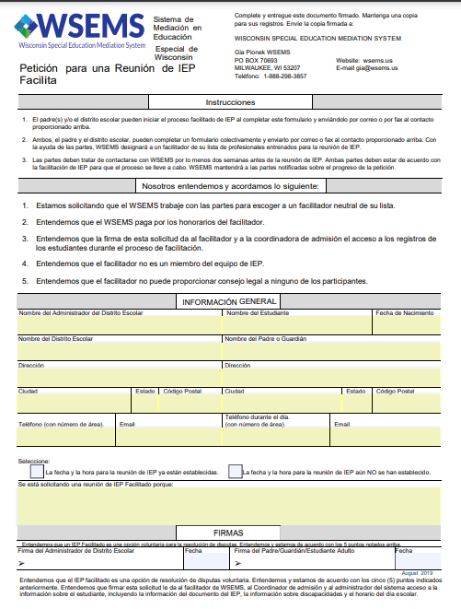
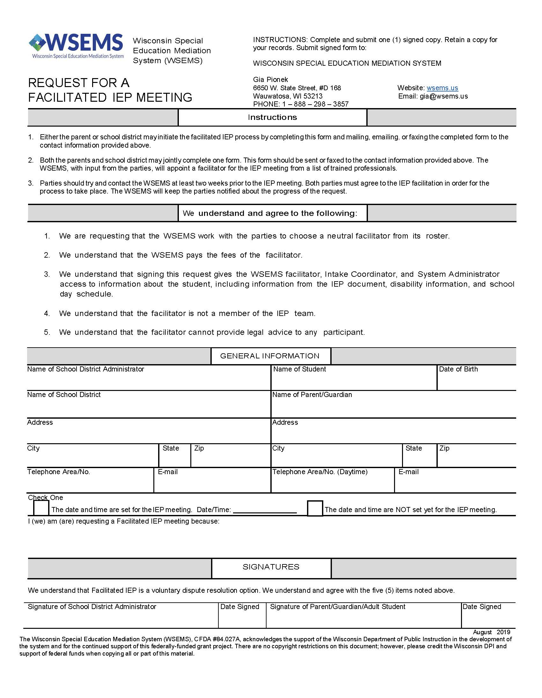
Solicitud de facilitación del IEP
Póngase en contacto con WSEMS: 888-298-3857
Complete el formulario de solicitud de IEP facilitado Solicitud conjunta o individual
Proceso voluntario
Admisión y detección de casos
Notes:
NISSAN SLIDE
If parents or school district staff think that an IEP Facilitatioin is the right option, then the parents or school staff, or both can make the request for a Facilitated IEP.
They can contact WSEMS to request an IEP Facilitation. They can obtain the Request for a FIEP form online or write, or call WSEMS. A copy of the form with the contact information is in your packet.
When the request is made, Gia, the Intake Coordinator will describe the IEP Facilitation Process and answer questions. Gia will be available as a resource throughout the process.
If one party requests facilitation, then Gia will contact the other party and they will have up to five days to respond “yes” and “no.” Because the Facilitated IEP process is voluntary, if either party says “no”, then the IEP will be held without using the WSEMS’ Facilitated IEP option.
If both parties agree to participate in an IEP Facilitation, the meeting will be held at a time and place acceptable to all IEP team members and the facilitator.
If a date has already been set for an IEP meeting, Gia will find a facilitator who is available on that date who the parties agree to work with.
If the date has not been set then the selected facilitator will work with the parents and school to find an acceptable date and time.
In either case, the School District is responsible to send out an IEP Invitation letter, and adhere to the legal IEP timelines.

Slide 9
Participantes de la facilitación del IEP
Los participantes del IEP facilitado son los mismos que asisten una reunión regular de IEP
El facilitador de WSEMS (no es miembro del equipo del IEP)
Notes:
NISSAN SLIDE
Participants of a Facilitated IEP meeting are the IEP team members who are normally required to be invited to attend the IEP meeting, as well as the Facilitator.
The Facilitator, however, is NOT a member of the IEP team, and does not get involved in content related discussions such as should the student spend more time in regular education,
The next slide will describe the role of the facilitator.

Slide 10
Rol del facilitador
Su papel es ayudar en el proceso del IEP
Mantiene al equipo enfocado en desarrollar el documento del IEP
Aclara los puntos de acuerdo y desacuerdo, mantiene una comunicación abierta y respetuosa
Ayuda al equipo a discutir pasos específicos de lo que ocurrirá después de la reunión del IEP
Ofrece formas de abordar/resolver conflictos
No toma decisiones por el equipo del IEP
Notes:
NISSAN SLIDE
As you can see on the slide, (read first 3) the facilitator’s role is to help keep the parties focused on needs of the child and developing the IEP by assisting with problem-solving and the discussion of mutual goals.
The facilitator can clarify points of agreement and disagreement and reframe points of disagreement into a manageable discussion.
The facilitator can help the IEP team discuss specific steps of what will occur after the IEP meeting, ”Who does What , When and Where” and suggest ways to address future conflicts
The facilitator makes no decisions for the IEP team. Only the IEP team members determine all decisions related to content areas that we discussed before.

Slide 11
Encuestas a los participantes - Facilitación del IEP 2004 – 21 (n=1,992)
Satisfecho con el proceso de Facilitación del IEP - 91%
Sintieron que la facilitación les dio la oportunidad de ser parte de la toma de decisiones - 85.6%
Volvería a utilizar la facilitación del IEP: 90,8 %
Volvería a utilizar el mismo facilitador: 89,1 %
Pensó que el facilitador fue imparcial durante todo el proceso: 89.4%
Encuestas para facilitadores: 2004-2021 (n=490)
Discapacidades más comunes - Autismo (39,5%); OHI (30%)
Asuntos más comunes: ubicación, adaptación, planes de intervención conductual
Notes:
Nissan

Slide 12
Mediación de WSEMS
Opción para la resolución temprana de conflictos
Un profesional capacitado e imparcial (mediador) ayuda a las partes a llegar a su propio acuerdo
Confidencial
Gratis
Notes:
COURTNEY SLIDE
In mediation, a trained impartial person, a mediator from the WSEMS roster of neutrals, facilitates discussion and helps parties reach their own agreement.
Since IDEA 1997, mediation is the dispute resolution option required by federal and state laws to be available for FREE to schools & parents
We have provided you with our WSEMS Mediation Manual.
The manual includes an overview of process, and three sections – the parents (p.10-23); the school representative, and atty/advoc (p.37-43)
The manual is helpful to all individuals considering mediation as it provides ideas, forms, and techniques useful in preparing for mediation
Confidentiality is another hallmark of the Mediation process and accordingly there are Confidentiality provisions are in both federal & state laws and are important to participants because they feel they can share more and discuss different options if the process is confidential. The mediator may not be called to testify in any future civil proceeding.
Further, unlike some other states, WSEMS , through its stakeholder council, decided that even the names of the parents and school districts would not be shared as part of the data provided to DPI or any other agency. WSEMS shares with DPI and the public the number of requests, the number who declined to use the service, the number of agreements reached. All parties to the mediation sign a confidentiality provision before mediation starts
Discussions in mediation must remain confidential within limits of laws mentioned.
No records are kept by the mediator.
If a mediation agreement is reached –only the parents and the school get a copy (not the mediator, WSEMS or WDPI.)
Clarify – if you have used FIEP process, you can still use Mediation if you think more work needs to be done to resolve the issue.

Slide 13
Cuándo solicitar la mediación
Al principio del proceso (disputa específica, punto muerto)
Cuando se debe haber hecho una remisión para educación especial
Para asuntos relacionados con: evaluación, ubicación, identificación de discapacidad, IEP, provisión de FAPE
Otras razones:
Necesidad de soluciones creativas y flexibles
Necesidad de mirar hacia el futuro
Ahorrar costos
Permitir que las partes tomen las decisiones.
Para preservar las buenas relaciones.
Necesidad de privacidad
Notes:
COURTNEY SLIDE
Mediation is best used when:
help is needed to settle a specific dispute
communication between the parties is not or has not been constructive and productive in the past
when Impasse has been reached (i.e., discussion has hit a “brick wall”, no movement forward), or when there is a strong history of dispute between parents & school.
It is important to note that a referral for special education must have been made for a case to be eligible for mediation
Other reasons for mediation:
The possibility for creative, flexible solutions
Forward-looking process )focus on the future)
Cost savings(resolve quickly, avoid time/expense of preparing for/participating in due process hearing
The parties are the decision makers
The chance to preserve good relationship
Perhaps most significant impact of mediation is establishment of a collaborative partnership that not only helps in resolving the present dispute, but also provides parents and schools with a framework to resolve future disputes. In addition, every step of the mediation process is voluntary. You only participate if you want to; you can stop any time you want to. If a parent requests mediation, the school does not have to agree & vice-versa. And, no one other than Jane Burns knows which parent/schools or even which school districts request mediation.

Slide 14
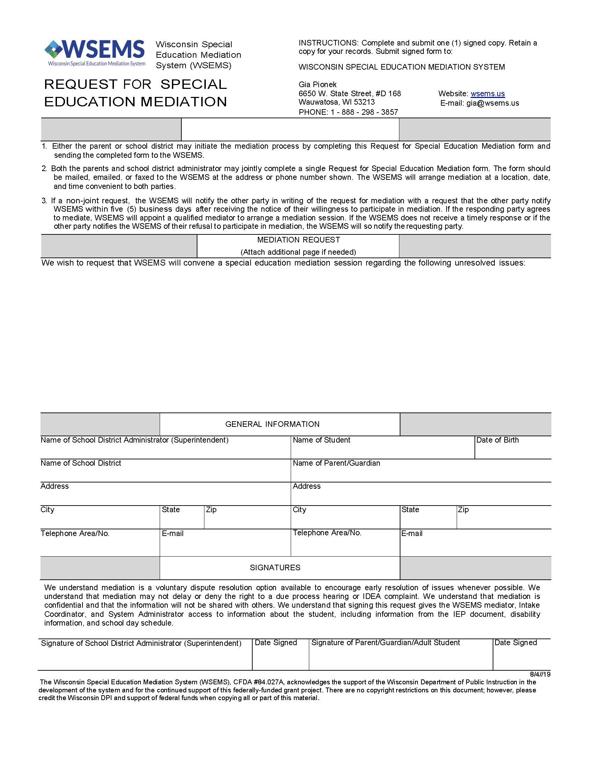
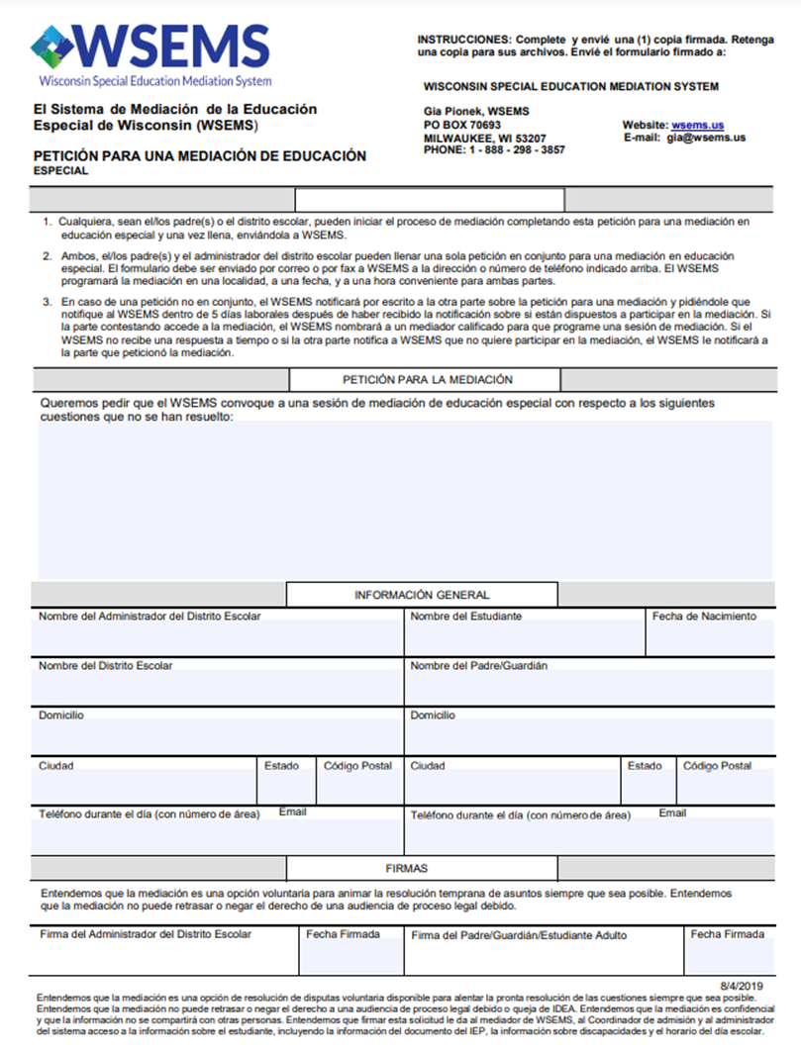
Solicitud y programación de mediación
Solicitud conjunta o individual
Descripción de la disputa
Firmar/fax/correo
Planificación
Notes:
COURTNEY SLIDE
Request for mediation must be in writing and sent to the WSEMS office
Usually the quickest way to get to mediation is through a joint request. Both the parents and school sign the request form; but the process can start with just one signature. A single request takes longer because Jane needs to follow up with the other party to get the 2nd signature.
Use Request Form (Mediation Manual – Appdx H);
There is a small space in which to briefly describe the dispute (for example, “transportation issues”)
Scheduling – Mediation will be scheduled within 21 days.
The mediator works with parents & schools to schedule the mediation session for a date and location convenient to both (i.e., so everyone can feel comfortable, safe environment – as public library, community center, bank, school)
Mediation usually takes part of a day and some parties may need an additional session if the issues are very complex. However the average is 4 ½ hours. When setting up the mediation session, the mediator generally asks the parties to agree on how much time they have available to meet. This may be a few hours or all day, depending on what the parties decide.
Once both parties agree to participate in mediation, the next step is for them to both agree on which mediator to use.

Slide 15
Participantes de la mediación
Los padres o el estudiante adulto competente
2 representantes escolares (puede incluir un abogado como uno de los representantes)
Las partes deben ponerse de acuerdo sobre cualquier otro participante que pueda asistir
Notes:
COURTNEY SLIDE
The mediator also asks the parties to identify WHO else they would like to have participate in the mediation.
Our WI law provides that mediation participants automatically may include
2 parents (or competent adult student) &
2 school reps (since school reps were not defined further, 1 can be the school attorney)
Per our law, other people can participate – but the parties must agree on who those additional people can be.
Any other people that parents would like to have attend – i.e., relatives, neighbors, advocates, attorneys, for example, must be approved by the school.
Additional people the school feels would be useful – i.e., other IEP team members, etc. – must be approved by the parents.
If the parties have been working with attorneys prior to the mediation it is usually, better to have them in the room so that they can hear the discussion. Otherwise, the attorneys will be consulted after the meeting or during the meeting by phone or email. Since the attorneys have not been part of the meeting it can take more time to discuss what has happened. In addition, the attorneys may be helpful in providing legal advice as mediators are not allowed to give legal advice.

Slide 16
Rol del mediador
Programar la mediación
Ayuda a la escuela y al distrito a decidir quién participará
Ayuda a los participantes a comprender cómo funciona la mediación.
Facilita y estructura la discusión entre los participantes.
No es un tomador de decisiones
Sin asesoramiento legal
Ayudar a las partes a llegar a un acuerdo
Notes:
COURTNEY SLIDE
The mediator helps the district and the parents decide who will participate in the mediation session.
The mediator spends time to make sure that the participants understand what to expect from mediation
The mediator’s helps facilitate and structure the discussion between participants during the mediation session
However, their role is not to impose a decision, they can not give legal advice or interpret law during a mediation session;
Their goal is to help parties communicate more effectively and to reach an agreement about their issues.

Slide 17
¿Qué hacemos en la mediación?
El proceso de mediación es informal
Todos los participantes a menudo en la misma habitación,
pero pueden tener sesiones separadas
El mediador explica y todos firman el Acuerdo para mediar
Se explica el proceso de mediación y el papel del mediador
Los participantes explican por qué están allí y lo positivo,
los resultados que les gustaría resolver su disputa.
El mediador puede hacer preguntas para aclarar,
intercambiar ideas, o crear opciones.
Sin audio, video o registro escrito de la sesión.
Notes:
COURTNEY SLIDE
The mediation process is informal.
Often everyone is in the same room;
Sometimes, mediator meets with participants separately (caucus).
OPENING:
At the start of the mediation the mediator goes over the Agreement to Mediate (Apdx G)
The mediator and the parties may review the confidentiality provisions of mediation.
Everyone present signs it.
DURING:
Mediator explains the mediation process & the mediator’s role
Mediator asks participants to explain why they are here and what they would like to see as a positive outcome to resolve their dispute.
Mediator may ask questions to clarify, brainstorm, or create options.
There is no audio, video or written record of the session.

Slide 18
Acuerdo de mediación
• Las partes trabajan juntas para escribir el Acuerdo de Mediación (detalles de cómo decidieron resolver su disputa)
Importante ser específico
Indicar si otros procesos pendientes (DPH, IDEA u OCR denuncia, litigio) se retiran como parte del Acuerdo.
Incluir una disposición para volver a la mediación si es necesario
Lenguaje obligatorio: todas las discusiones durante la mediación son confidenciales y no se pueden usar como evidencia en ninguna audiencia o procedimiento civil
Cómo los participantes planean compartir información
• El mediador puede redactar el acuerdo según las instrucciones o la redacción de las partes.
• Solo firman las partes (puede solicitar la revisión de un abogado primero, por cuenta propia)
• Copias del acuerdo...
Notes:
COURTNEY SLIDE
Mediation Agreement must be written. (Manual, p. 11,35.) There is not a specific form for the agreement.
Parties write down how they have resolved the issues. Agreement should be very specific (who is going to do what, by when)
If there are any pending processes, like DPH, IDEA or Office of Civil Rights complaint, or litigation pending, it is important to indicate if the parties have agreed to withdraw from the process
Include a statement that parties agree to go back to mediation if things start falling apart
Mandatory language – “All discussions that occur during mediation are confidential and may not be used as evidence in any hearing or civil proceeding”
Should include a plan to share information (Agreement should never be attached to the IEP)
Mediator can be write the agreement as directed/phrased by parties.
Mediator should not write the agreement for the parties – remember that the mediator can not give legal advice and there is a concern that the mediator might be practicing law without a license if they write the agreement in their own language
Once agreement is written, just parties sign it (parents/schl rep)
Either or both parties can have an attorney review the agreement
As stated before, only the two parties gets a copy of Agreement-not WSEMS / DPI.
In WI, agreement is legally binding - enforceable under WI contract law
WSEMS does not have responsibility for enforcement of agreement
People tend to follow terms of mediated agreements because they participated in developing the terms of the agreement
No guarantees that mediation will lead to an agreement.
But, even if mediation does not result in an agreement, the process often helps parties identify issues or reach a partial agreement on some of the issues, or may help communication in a long-term relationship

Slide 19
Encuestas de participantes - Mediación 2000 – 21 (n=3,275)
Satisfecho con el proceso de mediación
2000-21 90.6%
Volvería a utilizar la mediación
2000-21 92.6%
Usaría el mismo mediador de nuevo
2000-21 90.9%
Tasa de acuerdos escritos
2000-21 91.2%
Promedio de sesiones por caso
2000-21 1.4
Duración media de una sesión de mediación
2000-21 3.93 horas
Notes:
Courtney
Proud of our outcomes over the past 21 years.
Roughly 91% were satisfied with process
Roughy 93% would use the same mediation again
Almost 91% would use the same mediator again
Almost 91% of cases result in a written agreement

Slide 20
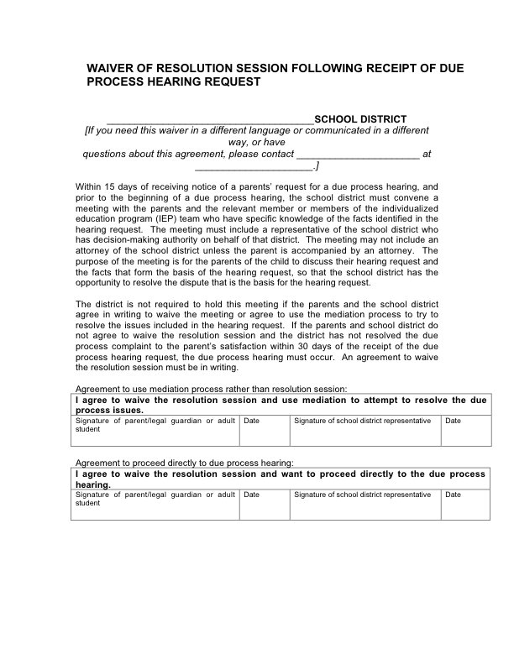
Proceso de resolución
Reunión de resolución
Cronologías
Se puede sostener con o sin un WSEMS neutral
Participantes: padres, representante escolar, miembros relevantes del equipo del IEP
Sin confidencialidad
Opción de renuncia
Acuerdo escrito
Notes:
NISSAN SLIDE
So far, we covered the WSEMS Dispute Resolution Options of IEP Facilitation and Mediation. The third option is Called The Resolution Process, and it occurs:
When parents file for a due process hearing, the school district has 30 days to resolve the issue.
IDEA requires the school district to have a meeting with the parents, called a Resolution Meeting, within 15 days of receiving the notice of the DPH request.
In WI, WSEMS can provide a neutral facilitator (for free) to help with the Resolution meeting - if the parents & school both agree.
Different from mediation - there is no confidentiality provision for the Resolution Meeting.
Participants can be: the parents, school rep w/decision-making authority, some IEP team members who know the issues that resulted in DPH; school may not bring an attorney unless the parents bring an attorney.
Slide shows “Waiver” form – if parents & school rep. agree, they can sign this form &, instead of having a Resolution Meeting, they can go right to the DPH; OR, they can go to mediation instead.
If there is an agreement from the Resolution Meeting, it has to be in writing.
If parents choose not to participate in the Resolution Meeting, the Due Process Hearing does not move forward.

Slide 21
Programa de divulgación
Sitio web
Capacitación
Difusión de materiales del Sistema en Español
Tipo de público:
padres y escuela
profesionales
http://wsems.us/es
Notes:
NISSAN SLIDE
Courtney, Nelsinia and I are the system’s primary outreach staff. We welcome requests for presentations to parents, school districts, blended audiences, professional organizations, etc. The Request form for Training or Exhibits can be found on the “Forms” tab of the WSEMS website. It is free a service by WSEMS.
Our website is located on wsems.us
We maintain WSEMS Website – Spanish mirror image
It includes, for example such documents as explanation of what is Mediation, who participates, mediator’s role, what is IEP Facilitation, who are the facilitators, how to prepare for an IEP Facilitation, how to contact WSEMS, list of the roster mediators, their bios & style of mediation, etc. Also, FAQ on Mediation, WSEMS forms, publications, archived webinars, audio presentations and other multimedia for 24-7 listening as well as many other resources.
We also disseminate a great deal of WSEMS materials (English & Spanish) through exhibits statewide or by mail upon request. All free.

Slide 22
¿Preguntas?
Notes:
COURTNEY SLIDE
Anyone have final questions?

