Slide 1


Literacy Training Series
Supporting Literacy at Home in the Summer
May 13, 2025
Jan Serak, MS
Notes:
Slide #1:
Procedural Directions:
2 weeks before webinar-
Before giving this webinar, check to see if any HOs have been updated & make sure to use the most updated version. Change slides if needed.
Check all the links to make sure they are all still “live.”
Create Polls in Zoom.
Load 5 Handouts (.pdfs) into the Zoom:
HO1_3 per page Session 3 PowerPoint Slides (English)
HO2: Reading Activities Everywhere
HO2: Sight Word Lists & Activities
HO3: Ways to Keep Middle & High Schoolers Interested in Reading; Incentives; Sight Words for PreK-1st grade
HO4: Summer Literacy Calendar for Early Childhood; Calendar for Elementary (Have to update this HO to Current year calendar – so use the Word version & then save as a .pdf). Be sure to save the Word version also to use for next time!!!
HO5: More Resources-Supporting Literacy at Home in Summer (Have to update this HO by checking all links on the .pdf version, make sure the links are live OR find & replace them with an updated resource. Change the Word version first as needed & then save changes as a .pdf). Save the Word version also to use for the next year to make any needed updates.
WEBINAR LOGISTICS
Use WI FACETS’ Zoom software.
---------------------------------------------------------------------------
Welcome everyone to this WI FACETS Webinar.
This is Jan Serak. I am the Founder of WI FACETS & retired as WI FACETS’ CEO a few years ago. I am the parent of a 2 adult sons, one of whom has autism.
I am excited to be with you all today for this webinar, Supporting Literacy at Home in the Summer. Let’s get started.

Slide 2

Agenda
What are we going to do today?
Facts about summer reading
Literacy, 5 components of literacy & support ideas
Picking out “right” books
More Ideas for summer
Resources
Notes:
Slide #2:
Procedural Directions:
Need HO1 (3 per page PowerPoint slides)
Show slide.
Presenter Notes:
Today’s webinar focuses on how important it is to keep children engaged in reading and literacy activities over the summer.
We are going to cover:
Some facts about the importance of summer reading
The definition of literacy &
The 5 components of literacy & ideas for supporting these 5 areas of literacy in the summer
How to pick the right book
More ideas for parents to support literacy in the summer
We will end with some Resources to check out for even more ideas.
One of your HOs is of all the slides you’ll see on your screen today. (HO1_3 per page PPt slides ).

Slide 3

August 5, 2025
Waukesha Technical College
https://wifacets.org/2025-endless-possibilities-conference/
Notes:
Slide #3a:
Procedural Directions:
Show slide.
Presenter Notes:
I want to give you all a head’s up about this year’s Endless Possitibilities. This is a really great annual conference organized by WI FACETS .
This year, it is Aug. 5th at Waukesha Technical College, from 8-3.
WI FACETS, along with the WI Statewide Parent Educator Initiative (WSPEI) and the WI Dept of Public Instruction partner on this conference to bring together experts to share their knowledge of important topics in special education with parents, school professionals, and other interested people.
This Year, you will learn about Augmentative & Assistive Communication, how to support engaged readers, and learn what others are doing to support positive outcomes for students with disabilities to achiever their goals.
Mike Hipple, a young man with a disability, is the keynote speaker. He will share his lived experience using technology in school.

Slide 4
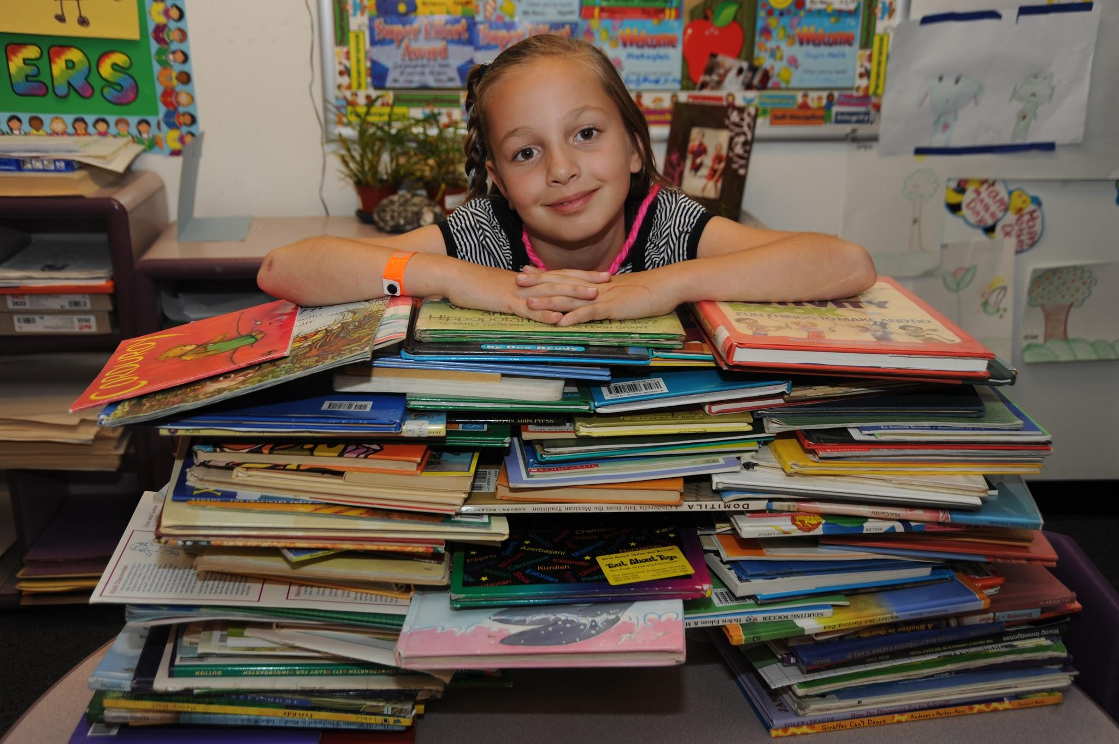
SUMMER READING IS IMPORTANT!
Notes:
Slide #3:
Procedural Directions:
Show slide.
Presenter Notes:
Let’s first look at some facts about the importance of summer reading.

Slide 5

Summer Slide
FACT:
Can lose up to 3 months of reading skills without practice over the summer
FACT: Students can lose up to 3 months of reading skills without practice over the summer
Notes:
Slide #4:
Procedural Directions:
Show slide.
Presenter Notes:
When summer comes, and children and families are busy with vacations, sports, swimming, and other things, it can be hard to find time for reading.
According to a Scholastic study, students can lose up to 3 months of reading skills if they don’t practice their reading over the summer.
They call this the “Summer Slide.”

Slide 6
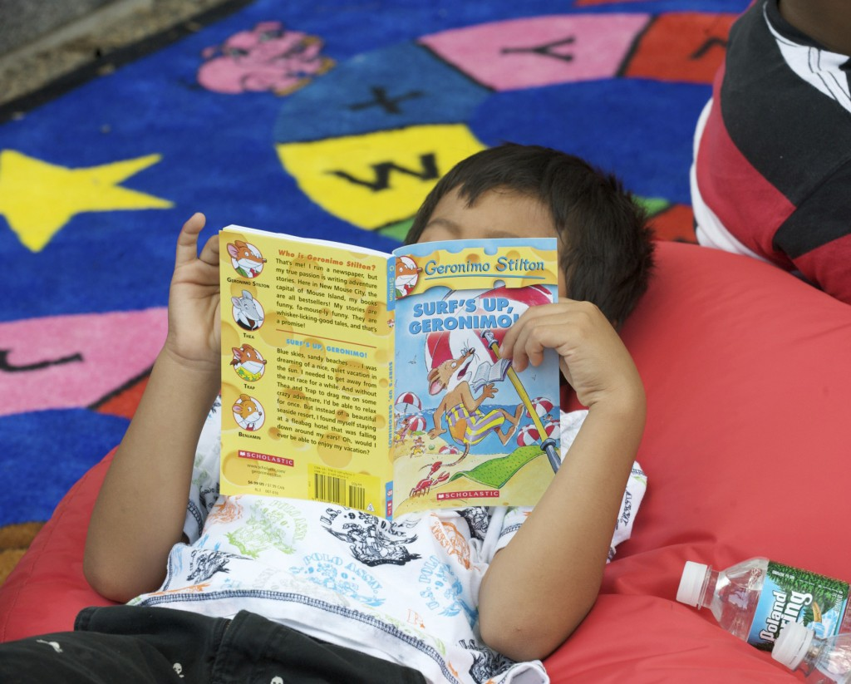
Avoid Summer Slide…
FACT: Students can lose up to 3 months of reading skills without practice over the summer
FACT:
Read 4+ books… do better
in fall
Notes:
Slide #5:
Procedural Directions
Show slide.
Presenter Notes:
Families can help their children avoid Summer Slide.
The research is clear:
Regardless of ethnicity, socioeconomic level, or previous achievement, children who read 4 or more books over the summer -that are at an appropriate reading level for them - do better on reading-comprehension tests when school starts in the fall than their peers who read one or no books.
At the high school level, reading 4 or more books over the summer has a positive impact on fall reading achievement –& is comparable or similar to attending summer school (Kim, 2004) http://mediaroom.scholastic.com/files/10CriticalFactsaboutSummerReading.pdf )
Research shows that there is a very strong link between reading volume and reading proficiency.
The Volume of reading is critical in the development of reading proficiency.
Volume is the time that students spend reading and also the number of words they actually understand the meaning of as they read. (Allington, 2012; Guthrie, 2004).
If families spend time reading with their children over the summer, not only will they avoid the Summer Slide, but their children’s skills will continue to grow!

Slide 7
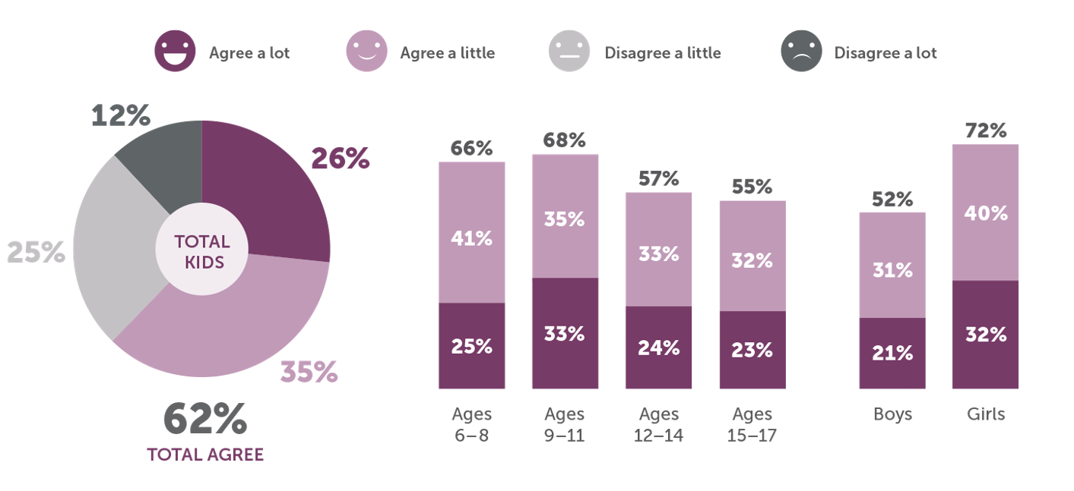
I really enjoy reading books over the summer…
FACT: 62% of kids LIKE summer reading
Notes:
Slide #6:
Procedural Directions:
[CLICK] for animation.
Show slide.
Presenter Notes:
Here are the results of a research study about children’s views on summer reading.
In response to the statement on your screen – “I really enjoy reading books over the summer” – you can see that enjoyment of summer reading is highest [CLICK] [CLICK] among younger children and [CLICK] girls, dropping as age increases and among boys.
[CLICK] On the chart for this study, you can see that between ages 6-17, about 6 of out 10 children (62%) say they enjoy reading books over the summer.
[CLICK] [CLICK] Also, you can see that even for 12- to 17-year-olds, that over 55% said they enjoyed reading books over the summer.
And, as I already mentioned, more girls (72%) than boys said they like summer reading.
The main things kids said about summer reading were “I just enjoy reading” (44%) & “It’s a fun way to pass the time.” (32%)
And only 4% of children said that they read just to get prizes or rewards.
However, if your child is one who DOESN’T like reading in summer, you CAN try using incentives.
That doesn’t mean spending money either. There are things you can do to acknowledge that your child put in the effort to read.
You have a handout called Ways to Keep Your Middle & High Schoolers Interested in Reading – at the end of it are a few ideas for INCENTIVES. (HO4)

Slide 8

FACT:
3rd grade reading proficiency correlates to success in high school and beyond
Benefits to Reading…
Exercises our brain
Improves concentration
Teaches kids about the world
Improves vocabulary & language
Develops imagination
It’s FUN!!!
https://www.aecf.org/resources/early-warning-why-reading-by-the-end-of-third-grade-matters/
Notes:
Slide #7:
Procedural Directions:
Show slide.
[CLICK] for animation.
Presenter Notes:
Another FACT from research – According to a report published by the Annie E. Casey Foundation, how WELL your child reads in 3rd grade could determine his or her success in high school and beyond.
It may seem to parents that their child has barely graduated from cut and paste projects in school before reading and math take center stage in their education.
Suddenly, parents find themselves opening books every night, listening to their child sound out words, and helping them understand the stories they are studying.
What is the significance of 3rd grade reading assessments in predicting a child's academic success?
Up to 3rd grade, children are learning to read. Starting in 4th grade, they are reading to learn.
If children don't have good reading skills by this time, it directly impacts their ability to learn properly and succeed in school.
Do parents’ efforts really matter in the overall academic success of their children? Absolutely YES!!!
Like anything, proficient reading takes plenty of practice.
[CLICK] There are benefits to reading – really at any level.
Reading exercises our brain, Improves concentration, Teaches children about the world, Improves vocabulary & language, and develops a child’s imagination.
It turns out that the time parents spend reading with their kids, including in summer, not only is it a great way to spend time together, but it also helps kids become more proficient in reading and will help them do better in school and will have a greater impact on their child’s life success.
Plus, its FUN!
---------------------------------------------------------------------
Link to the study: (Early Warning! Why Reading by the End of Third Grade Matters - https://www.publicschoolreview.com/blog/third-grade-reading-correlates-with-high-school-graduation-rates; https://www.aecf.org/resources/early-warning-why-reading-by-the-end-of-third-grade-matters/), (2017)

Slide 9
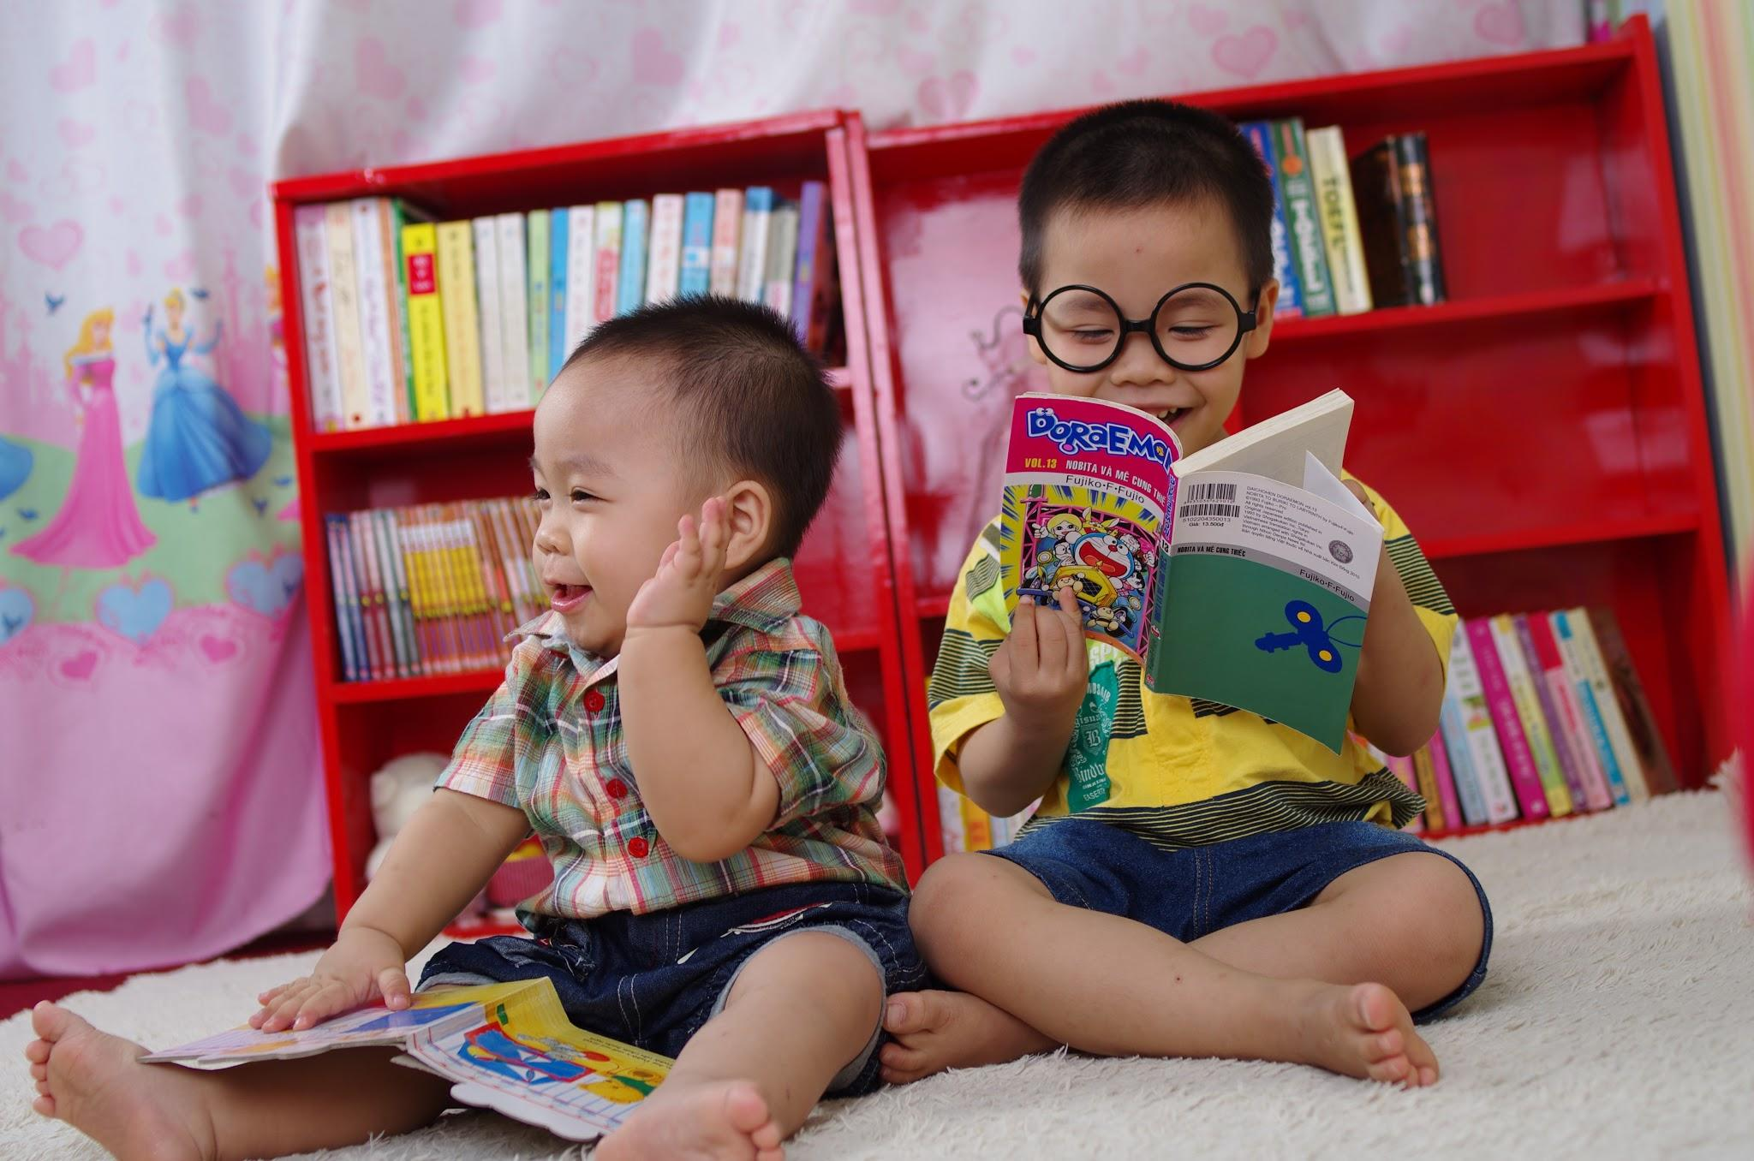
Access to Books
FACT:
The number of books at home is strongly linked to reading scores
Inexpensive books:
Rummage sales
Library sales
Little Free Libraries
Goodwill
Resale stores
Birthday gifts
http://teacher.scholastic.com/products/literacypartnerships/initiatives.html
Notes:
Slide #8:
Procedural Directions:
Show slide.
[CLICK] for animation.
Presenter Notes:
One early literacy expert concluded that “the only behavior measure that links significantly with reading scores is the number of books in the home.” The more books at home, the higher the reading scores.
Another study, of over 100,000 students, found that access to print was critical in children’s ability to acquire literacy skills.
Children whose parents have lots of books are nearly 20% more likely to finish college.
The number of books in the home is an even better predictor of college graduation than the education of the parents.
A child from a home with 25 books will, on average, complete 2 more years of school than a child from a home that has no books.
Regardless of how many books a family already has, each new book added to a home library helps the children get a little further in school. (Evans et al., 2010)
It is also important to consider that families can intentionally access print in their everyday environment with their children.
For ex, reading print on the bus ads; looking at magazines in the laundromat; reading print on billboards; reading road signs or reading print on trucks or stores along the road.
[CLICK] A parent can get free or inexpensive books lots of places – rummage sales, library sales, little free libraries (around town), Goodwill, resale stores. Kids can ask for books as gifts for birthdays & holidays.
--------------------------------------------------------------------------------------------------
Source: http://teacher.scholastic.com/products/literacypartnerships/initiatives.html
https://www.craftinc.org/literacy-e-books/americas-early-childhood-literacy-gap.pdf

Slide 10

LITERACY and
5 Components of
Reading
Notes:
Slide #9:
Procedural Directions:
Show slide.
Presenter Notes:
Now that we know some of the facts about WHY summer reading is really important, I just want to briefly touch on literacy and the 5 components, or areas, of reading.
And, then I’ll share some ideas for parents to help kids to develop in each of these 5 areas during the summer .

Slide 11






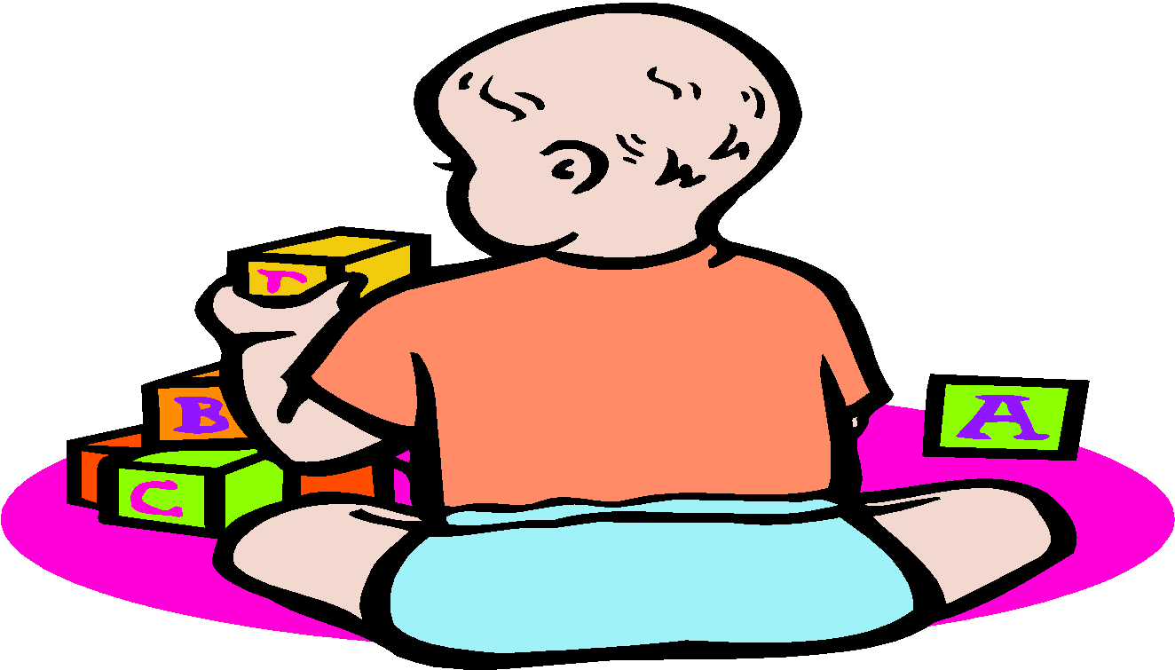


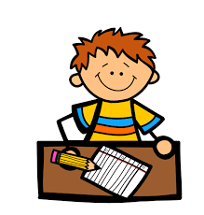

Literacy is ...
Literacy = reading, writing, listening, speaking, critical thinking. WI DPI
Notes:
Slide 10.
Procedural Directions:
Show Slide.
Presenter Notes:
SO, first, what is Literacy?
Often, when you hear the word “literacy,” most people think of literacy as just “reading.”
But, according to Webster’s Dictionary, “literacy” is the state of being able to read and write.
And, literacy truly is much more than this.
Reading is just one part of literacy – and isn’t really exactly interchangeable with the word “literacy”.
Literacy includes: talking, listening, traditional reading, reading aloud, interpreting pictures, creative play, scribbling and drawing, singing, and may include sign language or braille – among many other things.
The WI Dept. of Public Instruction defines literacy as reading, writing, listening, speaking, and critical thinking.

Slide 12
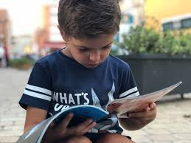
5 Components of Reading
Phonemic Awareness
Phonics
Fluency
Vocabulary
Comprehension
Notes:
Slide #11:
Procedural Directions:
[CLICK] for animation.
Show slide
Presenter Notes:
Reading is a really complex process. We often think that reading is just one single act – but our brains are actually doing a bunch of tasks at the same time when we sit down with a book.
[CLICK] The 5 components of the process of reading are on the slide:
phonemic awareness, phonics, fluency, vocabulary, and reading comprehension.
These 5 things work together to create the reading experience.
As children learn to read, they must develop skills in all 5 areas in order to become successful readers.
I am going to do a quick description of each one – and then share some tips that parents can do at home to help their child build skills related to that area.

Slide 13
Summer
Phonemic Awareness
Hearing and being able to change the individual sounds (phonemes) in words.
Clapping and rhyming games
Words with a specific sound (/sss/, /m/ or /ch/)
Sounds in all parts of words- beginning, middle, end (job/jot/jog)
Silly sentences with words that start with the same sound (Nobody was nice to Nancy's neighbor)
Notes:
Slide #12:
Procedural Directions:
Show slide.
Presenter Notes:
Phonemic awareness means hearing and being able to identify and change the individual sounds that we hear in words.
Children need to be taught to hear sounds in words and that words are made up of the smallest parts of sounds, or phonemes. They need to recognize and use individual sounds to read and spell words.
For example, the word hat has three sounds, /h/, /a/ and /t/.
Changing the first phoneme, the /h/ to a /b/ sound, changes the meaning of the word to bat.
Taking off the first phoneme, the /h/, changes the word to at.
Things families can do at home to help children with phonemic awareness. (*Some tips are from Reading Rockets)
Play clapping and rhyming games with your child.
See how many words your child can think of that start with a specific sound, like the /sss/, /m/ or /ch/ sound.
Play with sounds in all parts of words - beginning, middle, and end): like "job," "jot," and "jog," where the difference is at the end of the words.
Make up silly sentences with words that start with the same sound, such as "Nobody was nice to Nancy's neighbor".

Slide 14
Summer
The predictable connections between the letters and sounds.
Phonics
Point to letters/letter combinations – ask child to name the sounds
Say a sound - ask child to tell you the letter the sound represents
Point out words wherever you see them - say them out loud
Encourage your child to write notes, e-mails, letters
Make flash cards for “irregular” words (sight words)
Notes:
Slide #13:
Procedural Directions:
Show slide.
Presenter Notes:
Phonics means the predictable connections between the letters and sounds.
That is, learning all the rules for connecting letters and sounds so we can figure out what words are.
Words don’t always sound the way they look.
For example: the “a” in cake is long (c-aaaa-ke)but the “a” in cat is short. (c-a-t)
If the word is short and begins and ends with a consonant, it can be sounded out, like “sun & tin.”
If a word is irregular, like “laugh & though,” assigning sounds to letters to read or spell a word could be harder for the child.
Phonics includes learning letter & sound correspondences, spelling patterns, syllables, and meaningful word parts.
Things parents can do at home in the summer related to Phonics:
Point to letters and letter combinations and ask your child to name their sounds.
Say a sound and ask your child to tell you the letter the sound represents.
Look for words on signs, maps, billboards, cereal boxes, money, and birthday cards.
Point out words to your child wherever you see them. Say them out loud.
Encourage your child to write notes, e-mails, and letters. I love getting birthday cards, Mother’s Day cards, and drawings with notes on them from my 2 grandchildren!
Make flash cards to go over with your child to help them learn the “irregular” words – these are called “Sight Words.”
You have a HO called Sight Word Lists & Activities that can be helpful for making some flash cards so you can review sight words with your child.

Slide 15

Summer
Reading quickly, accurately, and with expression
Fluency
word recognition
reading comprehension.
  Partner reading – have your child read to you & help them sound out words they don’t know.
  You read the page first and have your child follow along.
  Listen to your child read favorite books over and over.
  Record your child reading the same passage several times and then listen to the recording for improvement.
Notes:
Slide #14:
Procedural Directions:
Show slide.
Presenter Notes:
Here’s the 3rd component – Fluency means reading quickly, accurately, and with expression.
Reading fluently is not the same as speed reading.
Fluency is kind of a like bridge between being able to recognize words and understand the meaning of what they are reading.
During the COVID 19 virus school shut down 5 years ago, my granddaughter was Instant Messaging me on her Chromebook. She was also doing“Partner Reading” with me as part of her school day.
She was in 1st grade then. I noticed, during the time we were doing this that her Fluency really improved.
Her expression while reading out loud to me also improved, which was really neat.
I am now an expert on Junie-B Jones & also on the Boxcar Children series – as we went through about 10 books during that time!
So, grandparents can also be super helpful with supporting reading from afar, just like I did for my granddaughter!
Other things that parents can do at home related to helping their children with fluency:
Help your child sound out words they don’t know.
You read the page first and have your child follow along.
Listen to your child read the same pages repeatedly until your child smooths out all the "bumps in the road." Reading those favorite books over and over again.
Record your child reading the same passage several times and then listen to the recording to hear the improvement.

Slide 16
Summer
The words we understand in reading and listening
Vocabulary
Lots of shared reading and talking about specific words.
Refrigerator magnets - create and discuss new words.
Study and learn word parts - root word + prefix or suffix as, kind, un/not, ness/state of being = unkind, kindness
Talk about the relationships between words - as, bucket/pail - good/bad.
Context, dictionary, ask Siri or Alexa
Vocabulary learning games: http://www.vocabulary.co.il/
Notes:
Slide #15:
Procedural Directions:
Show slide.
Presenter Notes:
Vocabulary means the words we understand in reading and listening.
The more words we know, the better we can communicate and understand what we read and hear.
Kids need to learn the meanings of words and know some strategies to find out the meanings of words they don’t know - so, figuring out the word from the context, using a dictionary, or, in this day and age… asking Siri or Alexa!
Kids also have to learn how to use the words correctly and practice using them in a sentence.
On your screen are some ideas for parents to use with their children in the summer to increase their vocabulary.
Lots of shared reading and talking about specific words.
Use magnets on the refrigerator.
I remember having magnets on my refrig when I was growing up. They were all letters of the alphabet and a few short sight words.
My dad would always make a new “word of the day” and then either my sister or I would try to be the first one to the refrig in the morning so we could make a sentence using the new word.
Study and learn word parts. If your child knows the meaning of a root word (“kind”), then he’ll know what the new word means when the prefix (“un”/not) or suffix (“ness”/state of being) is added. (unkind, kindness).
Talk about the relationships between words. Words with the same or similar meanings (“bucket/pail”), and opposites (“good/bad”).
I love the last bullet point. This link is a great place where parents can find literally thousands of vocabulary games to try with their kids.

Slide 17
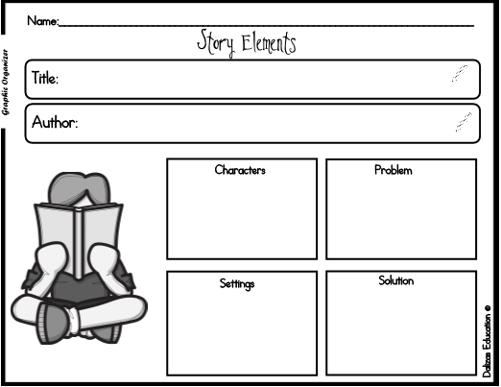
Comprehension
Understanding what is read
Summer
Use pictures for clues to meaning of words (context)
Use “retelling.” Child reads a page & retells you all they can remember.
Discuss what child has read – ask who, what, when, where, and how.
Connect with child’s own experiences.
Have child use a graphic organizer.
Notes:
Slide #16:
Procedural Directions:
[CLICK] Slide has animation.
Show slide.
Notes:
Comprehension is the 5th component of reading.
Comprehension is reason we read – Comprehension is understanding what we read.
When we read, our brains are doing 3 things:
trying to decode words,
recalling if we’ve ever heard that information before,
and comparing it to other information to see if it makes sense.
Some of the skills students need to learn related to text comprehension are:
Read both narrative texts (narratives are stories) and expository texts (expository means factual)
Understand and remember what they read
Relate their own knowledge or experiences to text
Use comprehension strategies
Communicate with others about what they read
Here are some things that families can do at home in the summer to help children with comprehension:
When reading with your child, if they get stuck, 1st ask them to try to use the pictures for clues about what the words mean (context).
Use “retelling”: Have your child read a page or story to you and retell to you everything they can remember.
Discuss what your child has read. Ask your child questions about the book.
Who is the main character of the book? Where did the story take place ? When did the story happen? What part of the book / story did you like best? What do you think will happen next? How does this story compare to another one you have read? Why do you think the author wrote this book / story?
[CLICK] Have your child use a graphic organizer (like on your screen) to outline what he/she just read.
Ask your child to connect the events in the book with an experience he/she had.
For example, if you are reading a book about a school field trip, ask your child to share about a field trip they have been on and how their experience was similar or different
Give your child many background experiences -such as: visits to zoos and museums; and activities, such as camping, cooking, shopping, hiking, and trips to other places.
Summer is a great opportunity for new experiences.
The more experiences a child has had, the more he can connect what he is reading to what he knows.
Your MORE RESOURCES handout has some great resources, including some short videos about each on of the 5 components of literacy that we just reviewed.
The MORE RESOURCES handout also has 4 training modules about literacy on WI FACETS’ webpage - to help you better understand the 5 components of literacy that we just quickly reviewed.

Slide 18

Reading is a Complex Process
Not ALL students with disabilities will master ALL components of reading
Recognize pictures/words
Choose books
Show awareness of being read to
Pay attention to reader
Print awareness (hold book, turn pages, talk about pics)
Notes:
Slide #17:
Procedural Directions:
Read slide
[CLICK] for animation.
Presenter Notes:
Finally, as we end this section, I just want to be sure to say that - Just because a student does not master all components of reading doesn’t mean they are not “literate.”
Some students may have difficulty with different components of literacy. Here are some examples:
A student with a language disability or ADD/ADHD may have difficulty with reading comprehension.
A student with significant Cerebral Palsy might not be a fluent oral reader.
A student with Autism, Central Auditory Processing Disorder, or other communication disorder may have difficulty with phonics.
Students with a reading disability, such as dyslexia, may need “unique” instruction based on the effects of the disability
For some children with disabilities, we might be looking for very different skills related to literacy, other than knowing words and picking up a grade-level book and reading it. [CLICK] For example, literacy for some kids might be -
Recognizing pictures or common words;
Choosing books to be read to them; (showing a preference shows an awareness and a level of literacy)
Showing awareness of being read to;
Paying attention to the reader;
Print Awareness - which might be getting the idea of what print is, learning how to hold a book and turn the pages, or talking about the pictures they see.
Parents can check their child’s IEP to make sure that, if their child’s current evaluation information shows that he/she has some reading challenges, there should be some Annual Goals related to literacy in the IEP.
During the summer, parents can especially focus on helping their child work on some of those IEP literacy areas. The child’s teacher may be really helpful with some suggestions for how parents can help in those areas during the summer, or even provide some fun activities to engage your child at his/her individual literacy level.

Slide 19
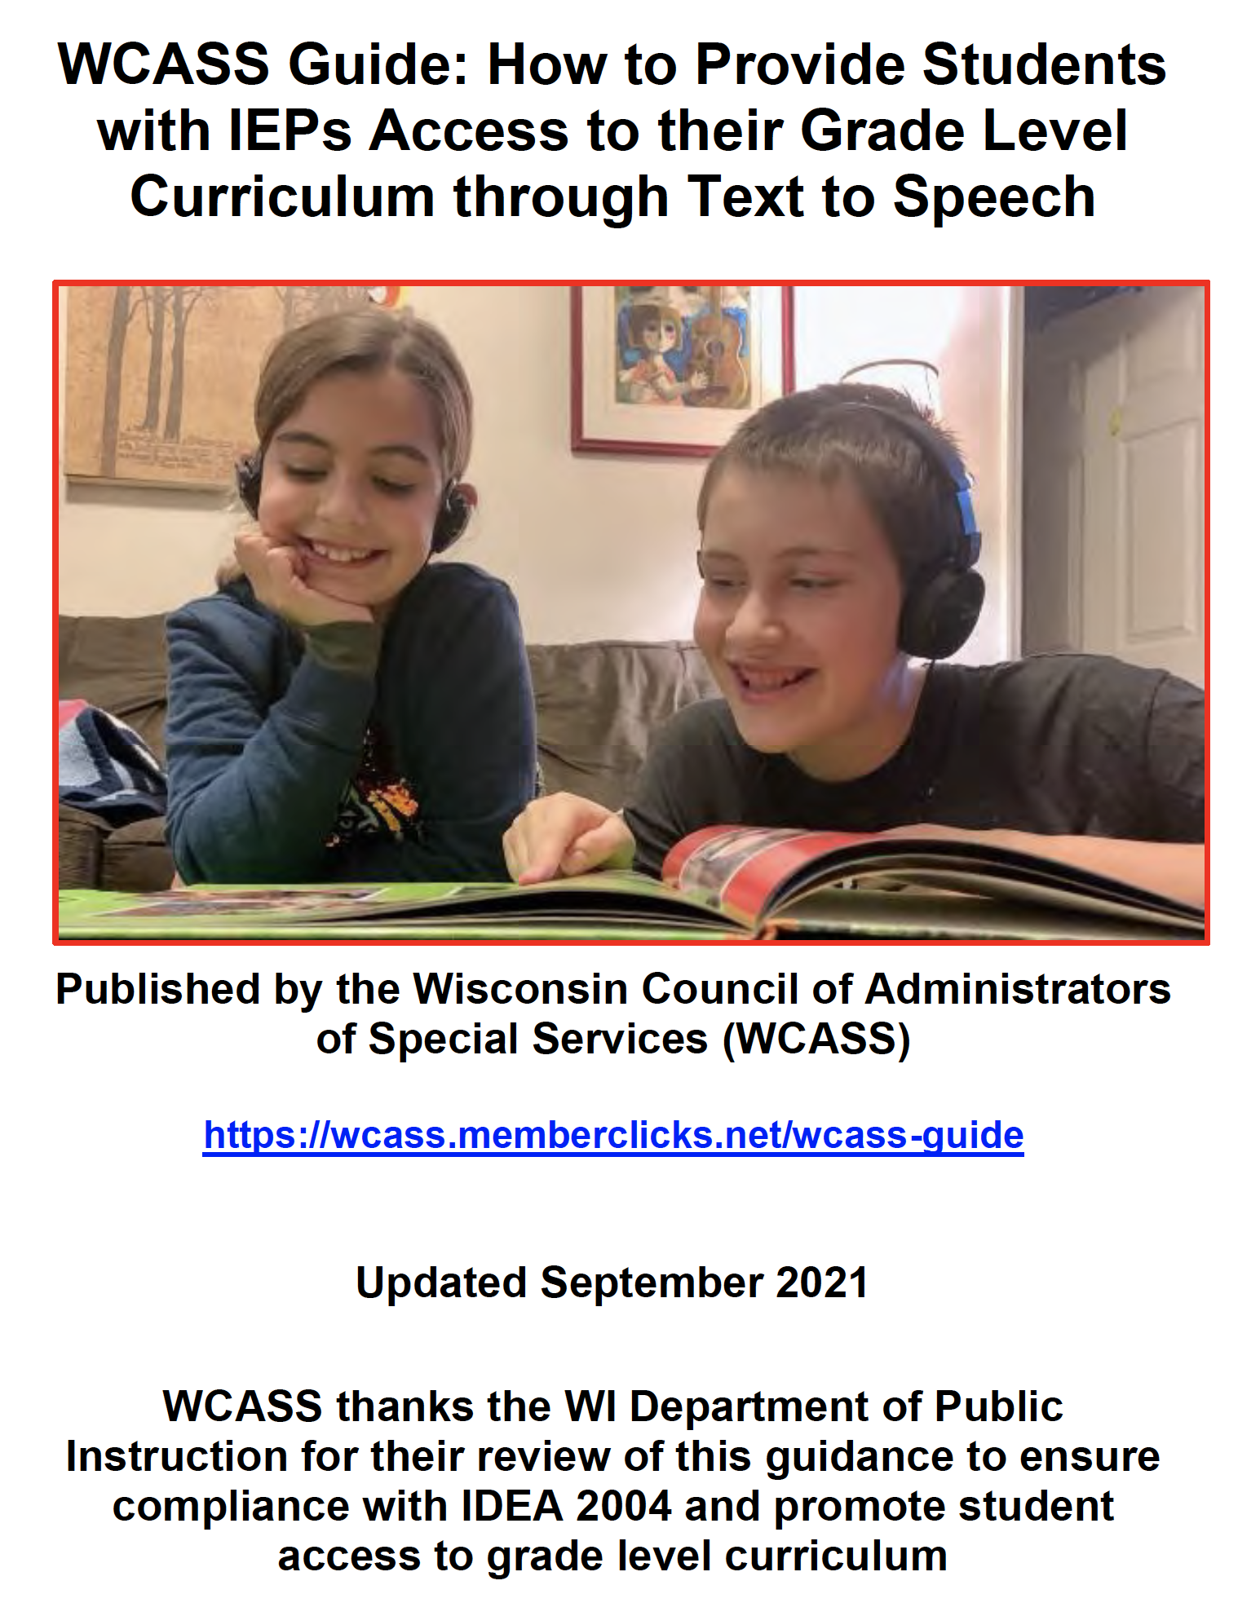
Reading is a Complex Process
https://www.wcass.org/wcass-guide
Notes:
Slide #18:
Procedural Directions:
Read slide
Presenter Notes:
I also don’t want to miss the opportunity to tell you all about a fabulous Wisconsin resource:
The WCASS Guide: How to Provide Students with IEPs Access to Their Grade Level Curriculum through Text To Speech was published in Sept. 2021 to help schools and parents understand why and how to support students with disabilities with access to their grade level curriculum.
It is full of great ideas for children who struggle with reading!
-------------------------------------------------------------
Reference: https://www.wcass.org/wcass-guide

Slide 20

PICKING OUT THE “RIGHT” BOOKS
Notes:
Slide #19:
Procedural Directions:
Show slide.
Presenter Notes:
In this next section, we are going to look at some different ways parents can help their child find the “right” books – books that are appropriate for their child’s reading interest and ability.

Slide 21
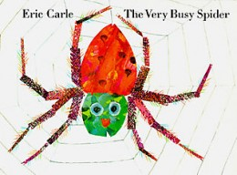
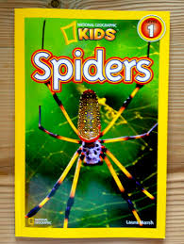
Finding the Right Books
  What is the purpose for reading the book?
Is it for enjoyment?
Is it to learn something?
Is it to listen to a book read by someone else?
Is it to read a book by themselves?
https://www.youtube.com/watch?v=TfL0g-XRxnA Book Title + Read Aloud
Notes:
Slide # 20:
Procedural Directions:
Show slide.
Animation
Presenter Notes:
One of the secrets to helping children find the just right books is to determine the purpose for reading.
Our young literacy learners need to experience HOW to choose a book based on a purpose.
So, you need to decide -
If the purpose for enjoyment?
Is it to learn something?
Is it to listen to someone else read the book?
Or, is the purpose to read it by themselves?
By the way, for a lot of books, you can go on YouTube, put in the Title of a book & the words Read Aloud to see if you can find someone reading a book that your child has or might be interested to hear online.
[CLICK] on the link to hear someone read The Very Busy Spider book. (https://www.youtube.com/watch?v=TfL0g-XRxnA)
Sometimes, a child might be motivated to read a book by the title or by a friend’s recommendation.
My granddaughter found out that her friends were reading Junie B. Jones books when she was in 1st grade. So, she was highly motivated to start reading those.
When she was in 2nd grade, she was reading Babysitter Club books because her friends were reading them.
Now that she is in 5th grade, she loves to read scary, mystery books.
Exposure to reading all different types of books - poetry, picture books, fiction, nonfiction - helps children to find books they will enjoy, inspire them, and make them want to read more!

Slide 22
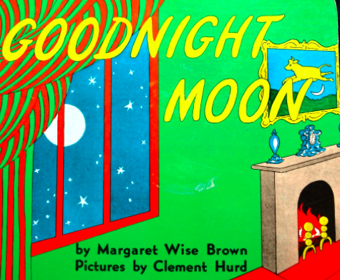
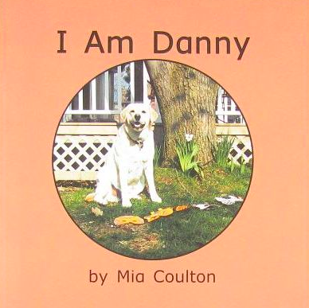

Finding the Right Books
Read
Aloud Books
Early
Reading Books
and
  Common Goals: To foster a love of reading, develop concepts about print/early reading skills as well as comprehension of what is read.
Notes:
Slide #21:
Procedural Directions:
Show slide.
Presenter Notes:
Finding the right kind of books to read can sometimes be overwhelming. There are so many books to choose from at the library, bookstore, online, and probably on your shelves at home!
Our goal is for our young readers to develop a love of reading!
This is done through many experiences with books such as:
listening to books read aloud
interacting with an adult by talking about what is being read, and
children trying to read some books on their own , too.
When we think about finding the right kinds of books for younger children, we can put them into 2 categories:
Read Aloud Books, which are books that are read TO the child by an adult/older sibling and
Early Reading Books, which are books that the child is beginning to read on his/her own.

Slide 23

Read Aloud Books
  Read Aloud Books are read to/with children.
Offer your child a few books to choose from
Have child to look through to find one that looks interesting
  Look at the cover
  Open it & see the pictures
  Read the back cover
During Reading
  Stop to talk about the pictures & words
  Ask questions
After reading
  Talk about the characters
  Retell what happened Talk about favorite part
  https://www.youtube.com/watch?v=uU1sX_Yg3JU
Notes:
Slide #22:
Procedural Directions:
Show slide.
Presenter Notes:
Read Aloud books are read TO or with children.
To help your child pick out books, it is a good idea to pull 3 or 4 books to narrow the choice for your child. Then choosing a book is not so overwhelming.
Show your child how a book is chosen: have them look through the books – have them look at the cover, open the book to see the pages and the pictures, read the back cover, see if the topic of the book looks interesting.
Then, have your child choose from the books you pulled to see which one he/she wants to read.
When my grandson was in 4K, he was into dinosaurs, so all the books he was picking to read were dino-related! Now he is in 4th grade & is reading books from a series called Dog Man and a series called Trapped in a Video Game.
Many times, children have a favorite book at home that they like to read over and over again.
This is great because your child can help you read the book.
This helps them develop a sense of story and start thinking of themselves as a “reader.”
You can help your child not only
develop a love for reading, but also to
develop some concepts about print/reading skills and get a good understanding of the story.
This is an interactive process.
While you are reading, you can stop to talk about the pictures and words. You and your child can both ask/answer questions - this helps with comprehension.
When you are done reading the book, you can both talk about the characters, you can retell what happened (from beginning to end) in the book, and you can talk about your favorite part of the book and your child’s favorite part of the book.
Here’s another YouTube link, at the bottom of the screen, to click on https://www.youtube.com/watch?v=uU1sX_Yg3JUto hear someone reading Goodnight Moon. (4 min long).
The links for these short videos are on your MORE RESOURCES handout.

Slide 24
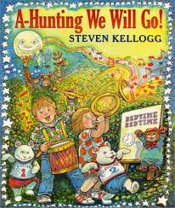
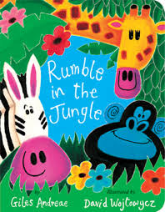
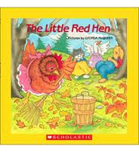
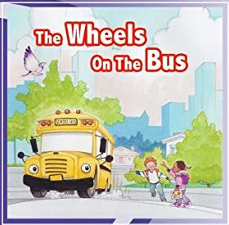

Suggestions for Read Alouds
https://www.youtube.com/watch?v=lf0vd6OhYbo
Notes:
Slide # 23:
Procedural Directions:
Show slide.
Presenter Notes:
Here are some ideas for possible read aloud books for little kids.
And, again, at the bottom is the YouTube link for someone reading the Wheels on the Bus. https://www.youtube.com/watch?v=lf0vdOhYbo

Slide 25
Early Reading Books
  Early Reading Books are read by children.
Encourage your child to go on a “picture walk”
Talk about things they notice
Look for new and tricky words
Talk about the book: predictions, questions, story elements (characters, setting, events, problem/solution)
Notes:
Slide #24
Procedural Directions:
Show slide.
Presenter Notes:
Early Reading books are books that are read by children.
To select early reading books, encourage your child to go on a “picture walk” – to explore the pictures in the book and talk about things they notice.
You can have your child look for new or tricky words.
Encourage your child to talk about the book - to make predictions (what do they think is going to happen in the book), to ask & answer questions about things in the book, and to identify story elements - such as, who are the characters, what is the setting (where is it taking place), and the events of the story (what is happening).

Slide 26



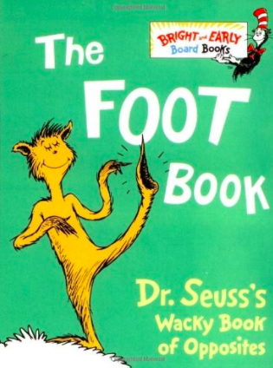

Suggestions for Early Reading Books
Notes:
Slide # 25:
Procedural Directions:
Show slide
Presenter Notes:
Here are some examples of books for children to read themselves-
Books that have a lot of rhyming words are a great choice.
They not only help the reader with decoding (or figuring out words they don’t know),
but they’re usually are also a LOT of fun to read!

Slide 27
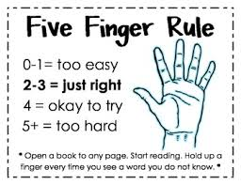
Finding the Right Books
Offer a few books - Look at the front cover, inside, back
Exposure to different types of books helps children find books they will enjoy, inspire them, want to read more!
Use the 5 Finger Rule”
Notes:
Slide #26:
Procedural Directions:
Show slide.
Presenter Notes:
One simple way to help your child choose books that are at an appropriate reading level for him/her is by teaching The Five Finger Rule.
This is the way it works:
Ask your child to open the book to any page and start reading.
Your child should hold up a finger every time he/she does not know a word.
If s/he cannot read 5 or more words on a page, the book is a difficult challenge.
If s/he can read all the words, the book is too easy.
If s/he struggles with 3 words, the book is appropriate.
But…don’t underestimate the willingness of a child to read a difficult book!

Slide 28
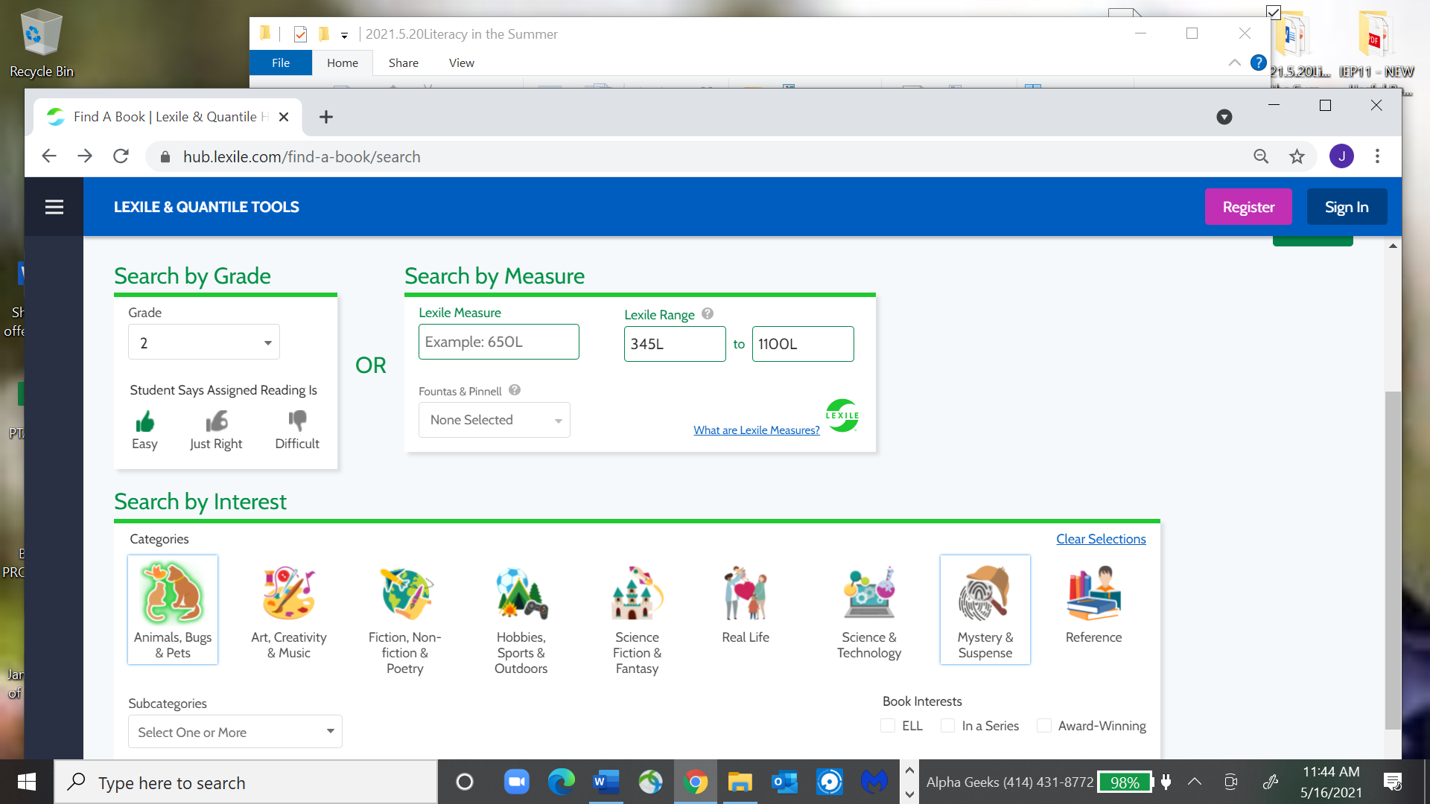
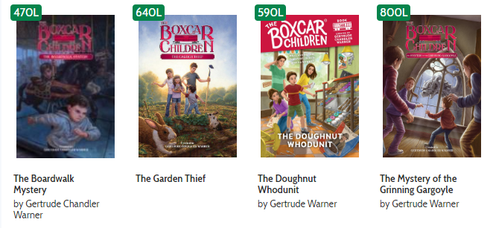
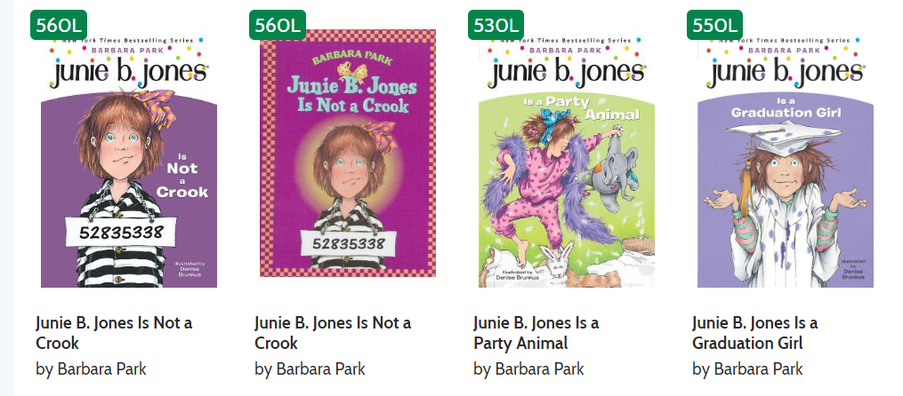
Finding the Right Books
https://hub.lexile.com/find-a-a-book/search
Lexile Reading System
Helps match readers to books at their reading level
Higher the #, more difficult the text (5L – 2000L)
Notes:
Slide # 27
Procedural Directions:
[CLICK] for animation.
Show slide.
Presenter Notes:
Another way to match a child, especially older children, with ideal reading level materials is to use the Lexile Reading System.
A Lexile Level is one way to measure the reading level of a book.
It doesn’t measure the level of the child; just the reading level of the book!
Lexile measures start at 5L.
The higher the number, the more difficult the text will be.
Anything below 10L is considered a “Beginning Reader.” The highest Lexile level is 2000L.
CLICK on https://hub.lexile.com/find-a-a-book/ If you go to the Lexile Reading System website, you can get an approximate range of Lexile scores for your child. (The Lexile link is also on your MORE RESOURCES handout.)
I tried this out for my granddaughter.
[CLICK] I put in “2nd “ when she was in 2nd grade for her grade level. You can pick grades all the way up to 12th.
[CLICK] I checked “Easy” because she said that the books she usually was reading were easy.
You could also check just right, or difficult.
[CLICK] When I did that, a Lexile score range for her popped up of 345L – 1000L.
I wanted to see if the Junie B. Jones series books that she was reading fit into that reading level range.
So, I went to the “Quick Search” box at the top of the webpage – and typed in Junie B. Jones.
[CLICK] Here were the results. So, the reading level of 560L would be right for her reading range when she was in 2nd grade.
I bought her the Boxcar Children series for Christmas that year.
[CLICK] When I checked that series out using the Lexile system, I was happy that they also fell into her Lexile level.
So, this is a pretty useful tool for parents and others to use to help in picking out appropriate reading level books for children and youth of all ages.

Slide 29
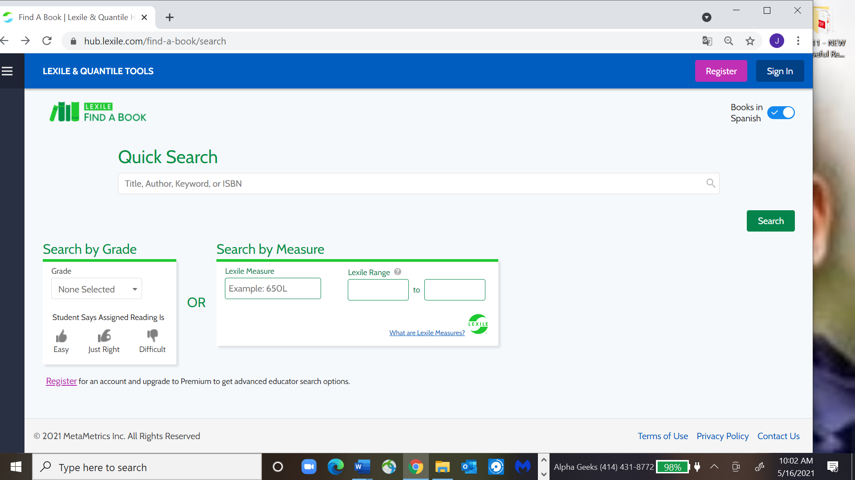
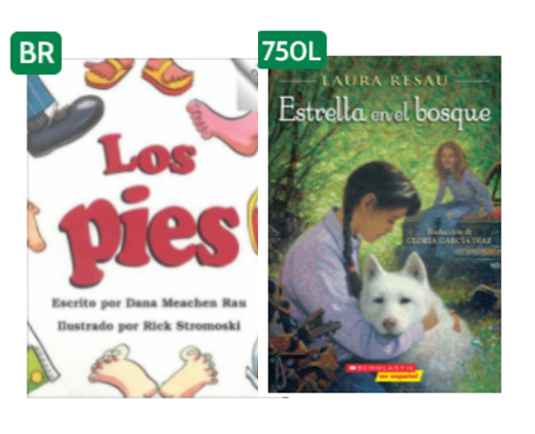
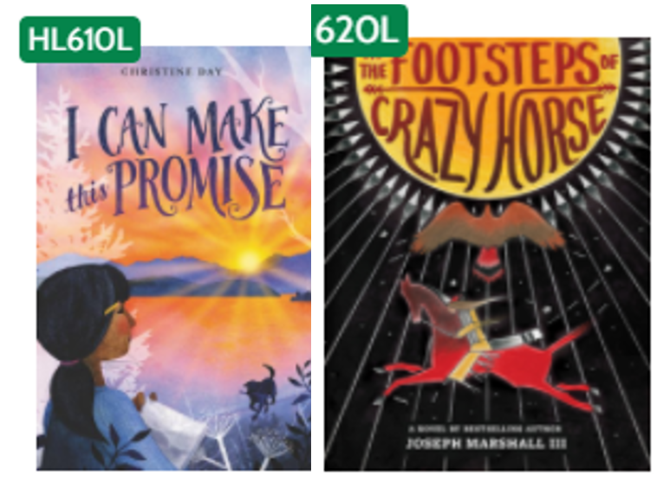
Finding the Right Books
Area of Interest
Books in Spanish
www.lexile.com/fab
Notes:
Slide # 28
Procedural Directions:
Show slide.
[CLICK] for animation.
Presenter Notes:
Two more things about this Lexile Level site.
[CLICK] First, this is also a great way to find books in areas of high interest to kids while also at their appropriate reading level.
I tried it out. In the “Quick Search” bar at the top of the Lexile webpage, I typed in Native American, and 37 book suggestions came up at my granddaughter’s appropriate Lexile levels, [CLICK] including these 2.
[CLICK] Second, you can also find books in Spanish.
I clicked the button at the top of the website -“Books in Spanish” –- and over 7,000 books came up in my granddaughter’s range of appropriate Lexile reading level books, [CLICK] including these 2 .
I urge parents to try using this great Lexile website to develop a list of appropriate Lexile reading level books for your child!
You can then use your list to find appropriate reading level books in the library, at a bookstore, to order from Amazon (or wherever), or to give out a wish list for birthday gifts, or when you are picking out books at a neighborhood Rummage sale!

Slide 30

IDEAS TO SUPPORT LITERACY IN SUMMER
Notes:
Slide #29:
Procedural Directions:
Show slide.
Presenter Notes:
So, in this last section today, we are going to look at how much a child should read, some literacy activities, and even more ideas for what you can do at home to support literacy for your child in the summer.

Slide 31
How much should a child read?
Notes:
Slide #30:
Procedural Directions:
Show slide.
Presenter Notes:
Some people say kids should read 20 minutes a day – or a few minutes several times a day for very young children, 10 minutes for young elementary kids.
But…getting a child to read that amount of time might be hard.
What is most important – is to get children to the point that they want to read.
So, the goal is really to build the child’s interest in reading, their drive to read, and the stamina to continue reading.
Stamina is defined as “a child's ability to focus and read independently for long-ish periods of time without being distracted or without distracting others.” (Reading Rockets)
How great would it be to call a child to dinner, and he says that he still has two more pages (or chapters) to read!!
Here are a few suggestions for building stamina.
First, vary the way reading is done (for young children this might be varied voices, singing part of the story, joining in).
For Read Alouds, remember – these are the books that are read TO the child - choose books to read to your child that are interesting and engaging to your child.
For Early Readers, remember- these are books that the child is starting to read on his/her own - choose books that they are interested in and are at their level of reading.
You can have your child read to himself. You can also have them read to someone else.
My granddaughter, who is 12 now, reads to her little brother. They both benefit!
It is important to celebrate time spent reading, and the enjoyment that children get from reading, rather than the exact amount of time that a child reads. (http://www.readingrockets.org/pdfs/edextras/51787-en.pdf)

Slide 32
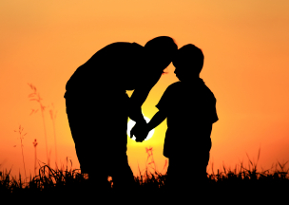
Support Literacy at Home
Comfy ‘reading corner’
Lot of books all over house
Board games (focused on literacy skills)
Closed captioning - have child read
Read book and watch
movie based on book
Family reading time
Share stories & discuss (newspaper, magazine, TV)
Read to/with your child
Notes:
Slide #31
Procedural Directions:
Show slide.
Presenter Notes:
Here are more ways you can support your child’s literacy at home:
Create a ‘reading corner’ – any place in the house where your child will be comfortable reading. You can decorate it and make it a special place to be. Put a bunch of pillows around and have a bunch of books there.
In summer, you can put up a hammock in the back yard for a place to read – or pitch a little tent.
Have lots of reading material around in other places of the house also – as in bookshelves around the house, on your coffee tables, in your child’s room (in the bathroom!). Try to keep books out at your child’s eye level so they are easily accessible, and so they catch their interest.
Play board games that are focused on literacy skills, like Apples to Apples, which also has a Junior version.
You could turn the closed captioning on your TV and have your child read the captions while they watch a favorite program.
If there is a movie on TV or at the movie theater that is based on a book, read the book first as a family and then watch the movie. – like read a Harry Potter book and then watch the movie.
Take time to read as a family – set a time in the house when everyone will be reading something.
Reading can also be a group activity where one person reads out loud and the others are listening and paying attention.
Share stories with your child – if you see something in a newspaper, magazine or a story on TV share it with him/her and discuss it.
And just simply read TO and/or WITH your child, if even for only a few minutes before bed, what a great way to get them settled in for the night!

Slide 33
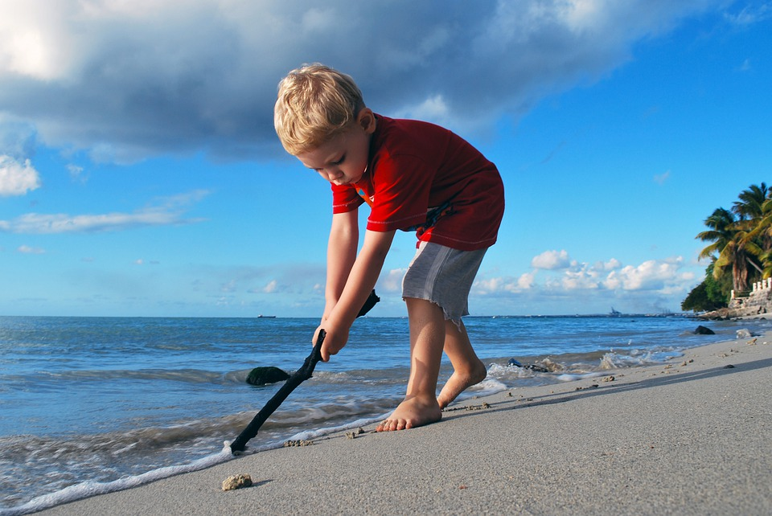
Summer Learning is About More Than Just Reading a Book
Notes:
Slide #32:
Procedural Directions:
Show slide.
Presenter Notes:
Summer learning is about more than just reading a book.
We learned at the beginning of this webinar that literacy is reading, writing, speaking, listening, oral language, and vocabulary.
So, there are many, many ways to engage children during the summer related to literacy.
Literacy includes all of the experiences you can provide your child within your home and community, including:
visiting parks, museums, zoos, going camping, nature experiences, drawing and art activities, writing, science, math, physical activity, singing, reading, playing, opportunities for making friends and solving problems, learning new vocabulary words which include feelings…and so much more.
One of your handouts for today is a bunch of literacy-related activities that you can do with your child in the various places in the community – at the Doctor, in the Park, in the Neighborhood, at the Mall.
This handout will give you at least some ideas of some fun ways to engage your child in the summer in literacy-related activities.

Slide 34
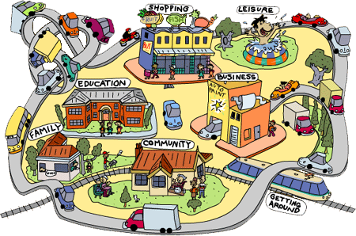
Literacy Activities in the Community
Notes:
Slide # 33:
Procedural Directions:
Show slide.
Presenter Notes:
When you are out in the community, point out print everywhere!
When Shopping at the Grocery Store, have your child help read the shopping list, read the labels, discuss prices or the qualities of the produce (What color is it? Is it bruised) or other items, look at the different choices for needed items, is something on sale?
Go on nature walks in a park near you - walk on the trails, making up songs as you go, walk to a beat you’ve created, play I-spy
Visit Museums. They often have materials created just for children to explore during and after the museum visit.
When you go out eat at Restaurants, have your child work on reading the menu, bring along a pad of paper, crayons, and pens to let them draw, write, or color while you wait.
When riding somewhere in the car – you can have audiobooks available for your kids to listen to (can get these at the library),
or have them link on a Tablet or i-pad to audiobooks. You can have another adult (not the driver) read books or have the kids read aloud. You can have the kids create their own stories.
You can play games with ABCs where you find the letters outside in order as you drive
Keep a few favorite books in the car, books that they can only read when in the car, this makes these books special (and keeps them occupied while you’re driving!)

Slide 35
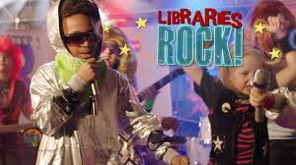

2025
https://dpi.wi.gov/libraries/public-libraries/youth-services/programming-resources
Notes:
Slide #34:
Procedural Directions:
Show slide.
[CLICK] for animation.
Presenter Notes:
OK, so Libraries ROCK for summer reading!
Going to the library once a week in the summer can be a wonderful way for your child to get new books and keep reading interesting and fun.
Get a library card for your child. Check out books, go to the library’s children’s programs.
You can talk to the librarians about what books would be good for your child.
Most libraries have a summer reading programs.
[CLICK] The 2025 Summer Reading Program for many Wisconsin libraries has for its theme: Color Our World
The link on your screen is where you check what the WI reading program theme is for each summer (https://dpi.wi.gov/libraries/public-libraries/youth-services/programming-resources)
If your library is participating in the reading program, you can see what books they have for your child that fit into the theme of the year. So, this year, they will probably have “Adventure” type books.

Slide 36
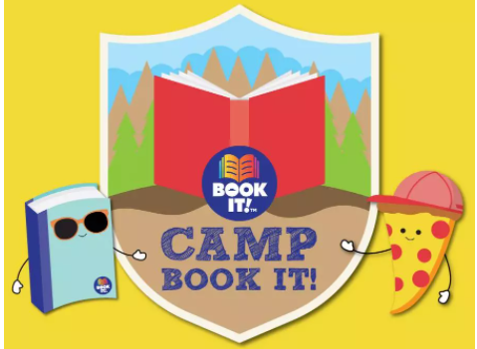


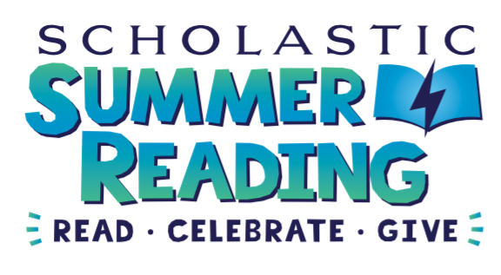
Free Summer Reading Programs
https://www.youtubekids.com/
https://www.bookitprogram.com/book-it-for-parents
https://www.youtube.com/watch?v=xzHq2JfqpWE
https://www.scholastic.com/site/summer/home.html
https://www.kcedventures.com
Notes:
Slide 35.
Procedural Directions
Show slide.
Presenter Notes:
How about having your kids join some free summer reading programs?
We already talked about the best free program – the library.
Here’s some other ones.
Scholastic Summer Reading – a free program with access to lots of books online. You can log on (link is on the screen), register on Home Base and then the child can record his/her minutes in “Reading Streak” and do activities. https://www.scholastic.com/site/summer/home.html
Parents can enroll their kids for Pizza Hut’s summer reading program- Camp Book It. When kids meet their monthly reading goals for June, July, and August they get a coupon for a free one-topping Personal Pan Pizza® from Pizza Hut. The website also has fun activities and book recommendations each week to keep the fun going throughout the summer! https://www.bookitprogram.com/book-it-for-parents
YouTube Kids 20 Minutes a Day Challenge - Read along with picture books, songs, and more — with YouTube Kids videos.
KCEdventures Genre Challenge-Challenge your kids to explore new areas of the library. KCEdventures has created a bingo-style printable page that covers 15 different genres (as, science fiction, poetry, humor, fantasy, adventure, etc.). Try to read at least one book from each and record them on the sheet.

Slide 37

More Places for Ideas
Notes:
Slide #36:
Procedural Directions:
Show slide.
Presenter Notes:
Finally, I already mentioned that you have a handout titled MORE RESOURCES.
This has a ton of resources to check out that Parents Can Do related to summer reading.

Slide 38
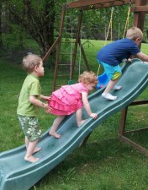
Support Your Child’s Literacy and
Beat the SUMMER SLIDE
Notes:
Slide #37:
Procedural Directions:
Show slide.
Presenter Notes:
One of your handouts for today is a SUMMER CALENDAR – there is one for Early Childhood Children and one for Elementary-Age Children with some things to do in the summer related to the 5 components of literacy.
Parents can also use the calendar to record what books your children read in the summer. We hope you have lots of books that you will be filling in for this summer.
And remember, kids who have access to books and literacy activities over the summer, can not only beat the summer slide, but they can actually make some good gains over the summer and be ready to start the new school year better off than they were at the end of the last one.
(http://www.prnewswire.com/news-releases/infographic-kids-who-read-beat-summer-slide-209508631.html )

Slide 39
August 5, 2025
Waukesha Technical College
https://wifacets.org/2025-endless-possibilities-conference/
Notes:
Slide #38:
Procedural Directions:
Show slide.
Presenter Notes:
I want to again encourage you to register for the Endless Possibilities conference on Aug. 5 at Waukesha Tech. College.
I forgot to mention that there will be a breakout session about Act 20 at the conference with a presenter from the WI Dept of Public Instruction.
The 2023 WI Act 20 is all about supports to districts and schools to ensure that children 4K-3rd grade are able to read proficiently by the end of 3rd grade.

Slide 40



CONTACT US …
www.wifacets.org
WI FACETS
600 W. Virginia Street,
Suite 501
Milwaukee, WI 53204
PHONE: (414) 374-4645
Email: Lori Karcher
lkarcher@wifacets.org
WI FACETS
Notes:
Slide #39:
Procedural Directions:
Show slide.
Presenter Notes:
Remember, if you have any questions related to this webinar, or wish to receive hard copies of today’s handouts, you can contact Lori Karcher at WI FACETS. Her information is here on your screen.

Slide 41
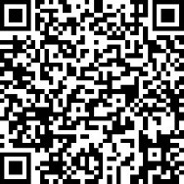
Here’s the Evaluation…
https://www.surveymonkey.com/r/TN95TB9
Notes:
Slide #40:
Procedural Directions:
Show slide.
Presenter Notes:
We would love you to complete an Evaluation of this webinar, as we are super interested in your comments.
You can complete it using the link or the QR code you see on your screen.
You will also get a follow-up email with the Evaluation link and the recording of this webinar. You are most welcome to share the recording link with others.
Thank you all for joining this webinar.
Have a great rest of your day. Stay safe and healthy!

Slide 42


Disclaimer Information: The Literacy Series was developed by WI FACETS under an IDEA Discretionary Grant (#17-13-WFCT-IDEA40/CFDA #84.027); and revised in collaboration with WSPEI, WDPI, and Early Childhood PSTs.
The views expressed herein do not necessarily represent the positions or policies of the WI Dept. of Public Instruction, U.S. Dept. of Educ./Office of Special Education Programs, WI FACETS, WSPEI, or other collaborating organizations.
No official endorsement by these organizations of any product, commodity, services, or enterprise mentioned in this resource is intended or should be inferred.

