Slide 1

Division of Vocational Rehabilitation:
DVR 101
FACETS Presentation
Sarah Kuehn and Amy May
Division of Vocational Rehabilitation (DVR)
Wisconsin Department of Workforce Development

Slide 2
What is DVR?
The Division of Vocational Rehabilitation (DVR) is a federal/state program that:
Offers individualized services to eligible people with disabilities who want to work. dwd.wisconsin.gov/dvr
Provides training and technical assistance to employers regarding disability employment issues.
Actively engages with roughly 18,000 consumers at any given time who are working toward an employment goal.
Notes:
The Division of Vocational Rehabilitation (or DVR) is a Federal and State program that has a dual customer model. We serve individuals with disabilities
Provide employment services and counseling to people with disabilities
Provide or arrange for services to enable an individual to go to work
Provide training and technical assistance to employers regarding disability employment issues
DVR is actively engaged with nearly 18,000 consumers with disabilities who are working toward an employment goal
https://dwdworkweb/dvr/organization/dvr-overview.htm
https://dwdworkweb/dvr/mission-values.htm

Slide 3
DVR Consumer Services
Services include, but are not limited to:
  Vocational counseling
  Skills development
  Internship / temporary work experiences
  Supported employment
  Education necessary to achieve career goals

Slide 4
DVR Mission
To obtain, maintain, and improve employment for people with disabilities by working with VR consumers, employers, and other partners.
Find a Job.
Keep a Job.
Get a Better Job.

Slide 5
What does DVR do?
DVR helps consumers develop an Individualized Plan for Employment (IPE) with their DVR counselor, which defines:
  The job goal
  The services needed to reach that goal
  The job seeker’s role and responsibilities
DVR also supports individuals with disabilities by providing career planning, training assistance, and connections to Wisconsin businesses.
Notes:
As the single largest source of disability talent in in the state, DVR provides employers with direct access to a well-qualified pool of talent.

Slide 6
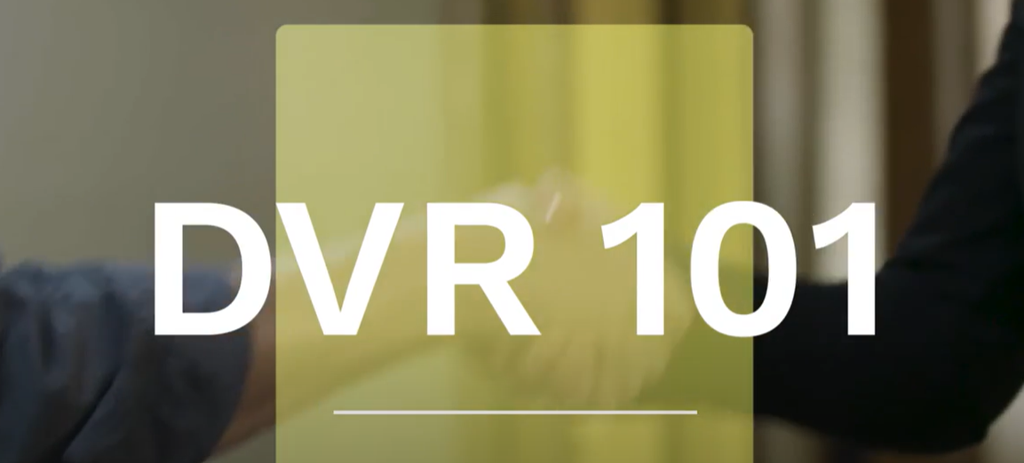
DVR 101 Video
Notes:
Right Click on DVR 101 picture and choose “open link” to play video.

Slide 7
Who is eligible for DVR services?
To be eligible for DVR services you must have a documented disability that presents a barrier to employment and requires DVR services.
DVR staff will work with the applicant to:
  Gather needed written documentation and information releases.
  Schedule a meeting to discuss the applicant’s disability and needs.
  Use existing information to the greatest extent possible (IEP, functional screen, previous medical records, etc.).
  Refer the applicant for additional assessment if needed.

Slide 8
Referral/Application Process
Referral to apply can be done online, by mail, or in person.
For those under 18 or those over 18 who are not their own guardian, the individual’s legal guardian must sign all documents.
High school students with a disability should apply to DVR at least two years before exiting high school.

Slide 9

DVR Partners
Service Provider
Network
Statewide Network of
Job Centers
Other DWD Divisions and Programs
Regional Workforce Development Areas

Slide 10
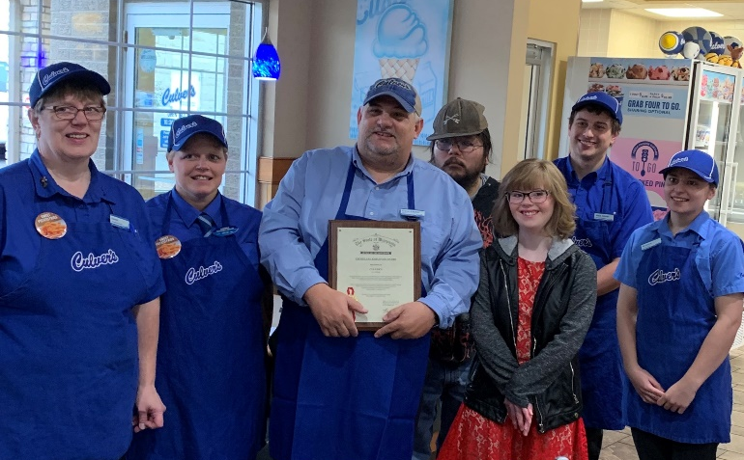

DVR: Premier Source of Skilled Talent
  At any given time, DVR has approximately 6,500 candidates who are ready to work in the full spectrum of employment and industry sectors in Wisconsin.
  DVR is committed to the success of our employer partners and the individuals we serve.

Slide 11

What is Project SEARCH?
  Project SEARCH is a nine- to 12-month transition program providing training and education to young adults with disabilities ages 18 to 24.
  Five days per week, participating
  interns report to their host business
  to learn employability skills in a
  classroom setting and hands-on
  job skills within the business
  environment.

Slide 12
Project SEARCH: Outcomes
  Since 2008, the program has provided training to over 1,800 Wisconsin residents.
  Project SEARCH is currently offered at 29 sites throughout Wisconsin in a variety of industries including health care, hospitality, and manufacturing.
  Wisconsin Project SEARCH sites have an average post-graduation employment rate of over 80 percent!

Slide 13
Pre-ETS Coordination with Schools
  Job exploration counseling
  Work-based learning experiences
  Counseling on comprehensive transition or post-secondary educational program enrollment opportunities
  Work-based readiness training to develop social and independent living skills
  Instruction on self-advocacy
  DVR may provide non-Pre-ETS to students as needed to reach their employment goal if student is a DVR consumer
Notes:
Amy
DVR can provide SWBL services to provide Job Shadows, TWE, SOJT.

Slide 14
Summer Programs for Youth with Disabilities
  Each program differs slightly in scope and duration, but all provide most or all the following:
  Internship development
  Career development and exploration
  Workplace readiness training
  Financial literacy training
  Paid temporary work experience
  Soft skills training (skills to pay the bills)
  For more information on youth summer programs in your area, contact your local DVR office.
Notes:
Each DVR Workforce Development Area (WDA) offers at least one youth summer program

Slide 15
Key Practices for Transition
  Invite DVR to IEPs or allow DVR to provide technical assistance for students with disabilities who are not DVR consumers but are considering applying for services in the future.
  Offer employment planning consultation through DVR, which can be provided for any student with a disability.
  DVR vocational counselors schedule and attend regular meetings with the high school.
Notes:
VRC’s can attend IEP’s when invited to provide employment planning consultation prior to DVR referral.

Slide 16
Best Practices: Interagency Collaboration
  Help connect people with barriers to employment by leveraging all available agencies and resources to support the individual during their job search and after employment.
  Focus should always be the consumer and their employment outcome.
  Every consumer’s case is different; therefore, success can look very different person to person.
  Communication, communication, communication!

Slide 17
Resources
  DVR Online Referral
  START = Statewide Transition Action and Resource Team
  DVR Transition Services
  DVR School Liaison List
  Transition Action Guide (TAG)
  Preparing for Life as an Adult: Transition Planning for Youth

Slide 18
Questions?

Slide 19
Division of Vocational Rehabilitation (DVR)
Wisconsin Department of Workforce Development
608-261-0050 or 800-442-3477 (Toll Free)
dvr@dwd.wisconsin.gov
Sarah Kuehn sarah.kuehn@dwd.wisconsin.gov
Amy May amy.may@dwd.qisconsin.gov

